Slide 1

DESERTIFICATION
SAHEL REGION

Slide 2

DATA VISUALIZATION
WEBSITE

Slide 3

CHIKKALA LAKSHMAN RAO
Chikkala Sri Lakshmanarao (2021101011)
Chikkala Sri Lakshmanarao (2021101011)
2021101011
GOWLAPALLI ROHIT
2021101113
ATREIDES
LOSETTI MOURYA
2021101121
PUNNAVAJHALA GNANA PRAKASH
2021111027
SAI MADHUSUDAN GUNDA
2021111028

Slide 4
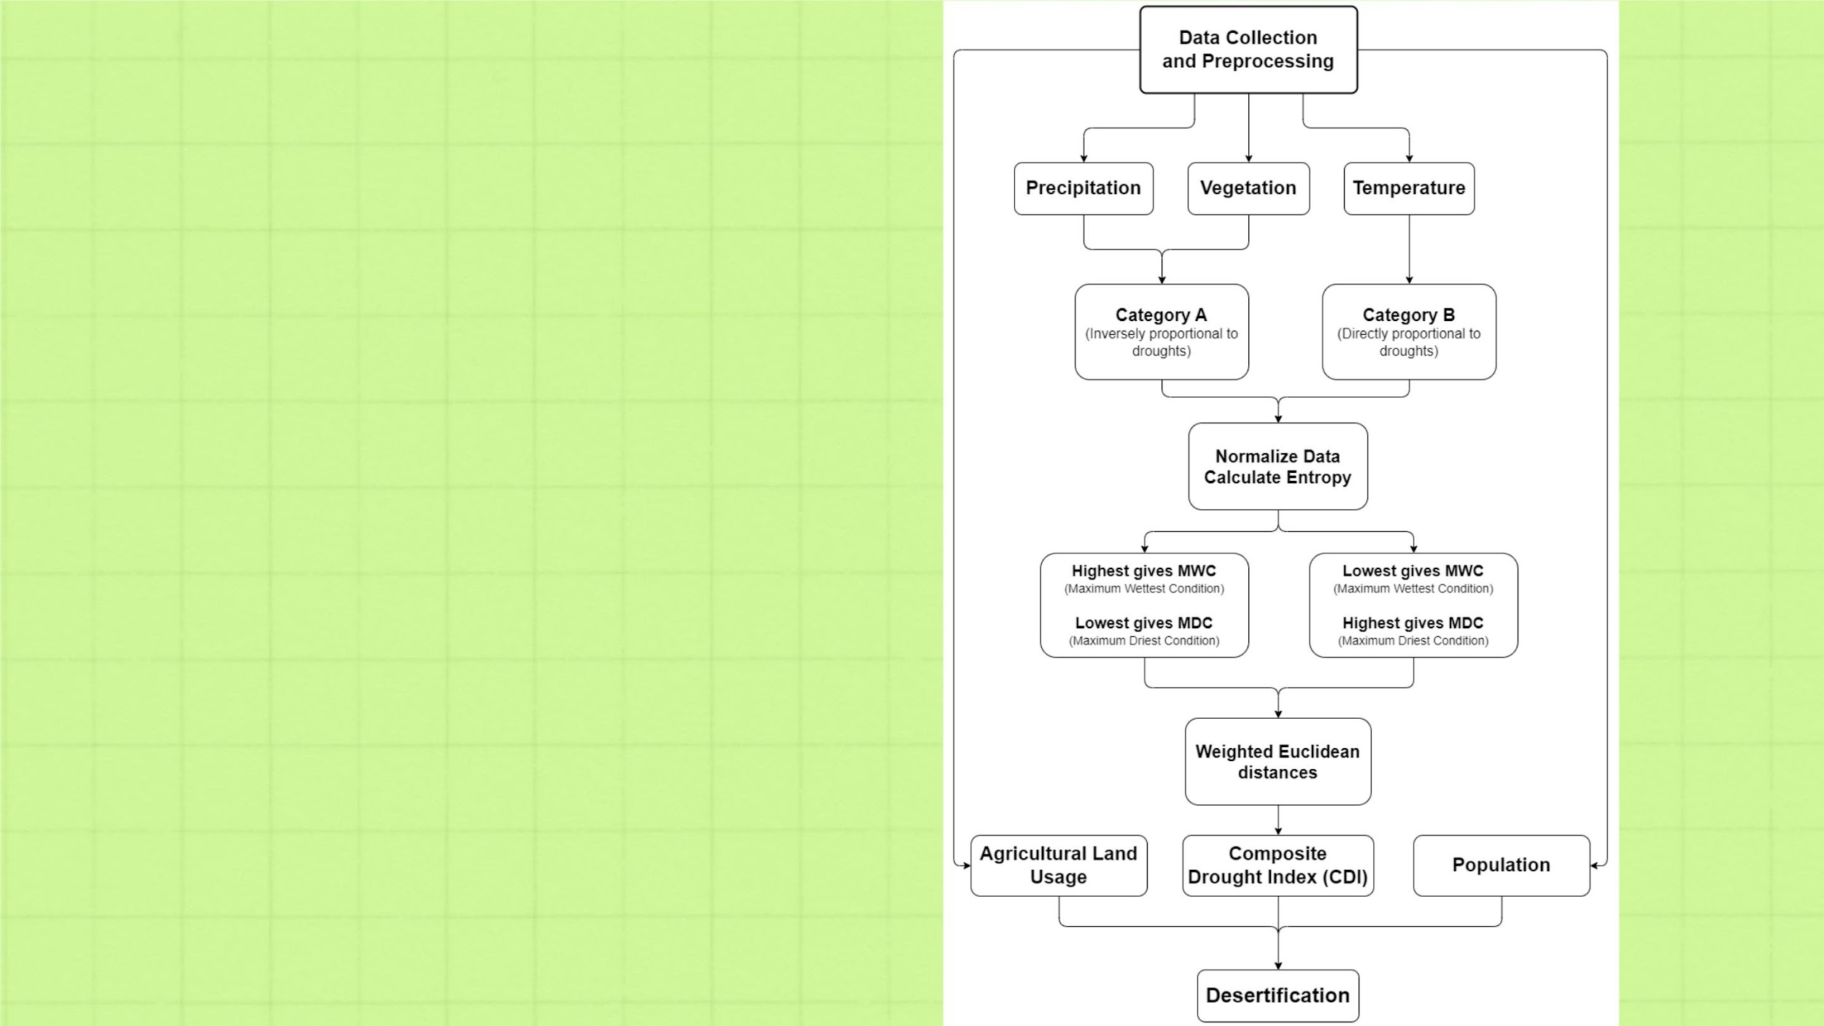
METHOD0LOGY

Slide 5
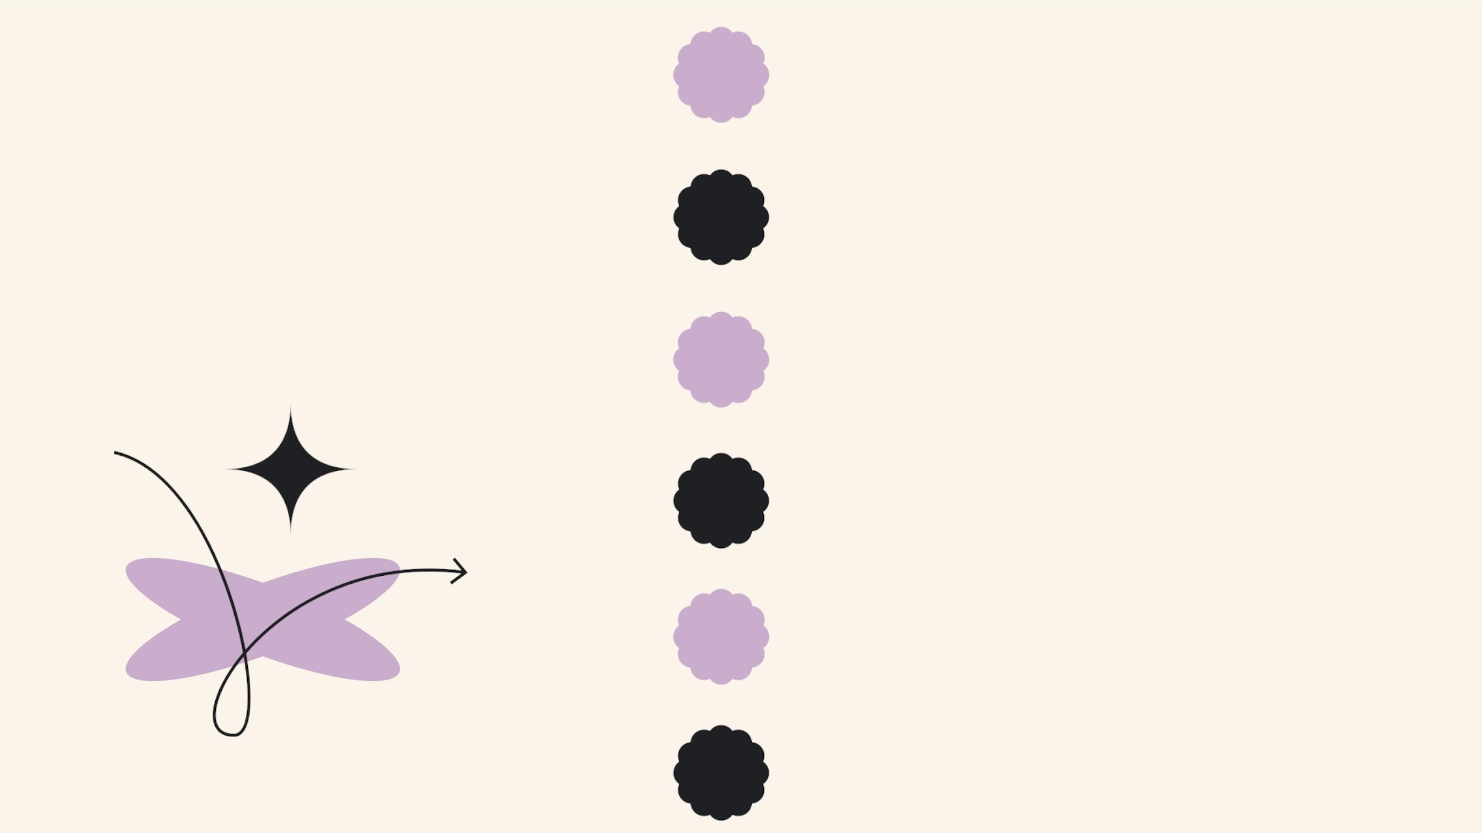
1
Composite Drought Index - CDI Dataset
Niger Agricultural Land - World Bank
Niger Precipitation - CHIRPS Dataset
Niger Demographics - Worldometer
Data Collection
2
3
4
5 Niger Population - Worldometer
Niger Land - Humanitarian Data Exchange
6

Slide 6
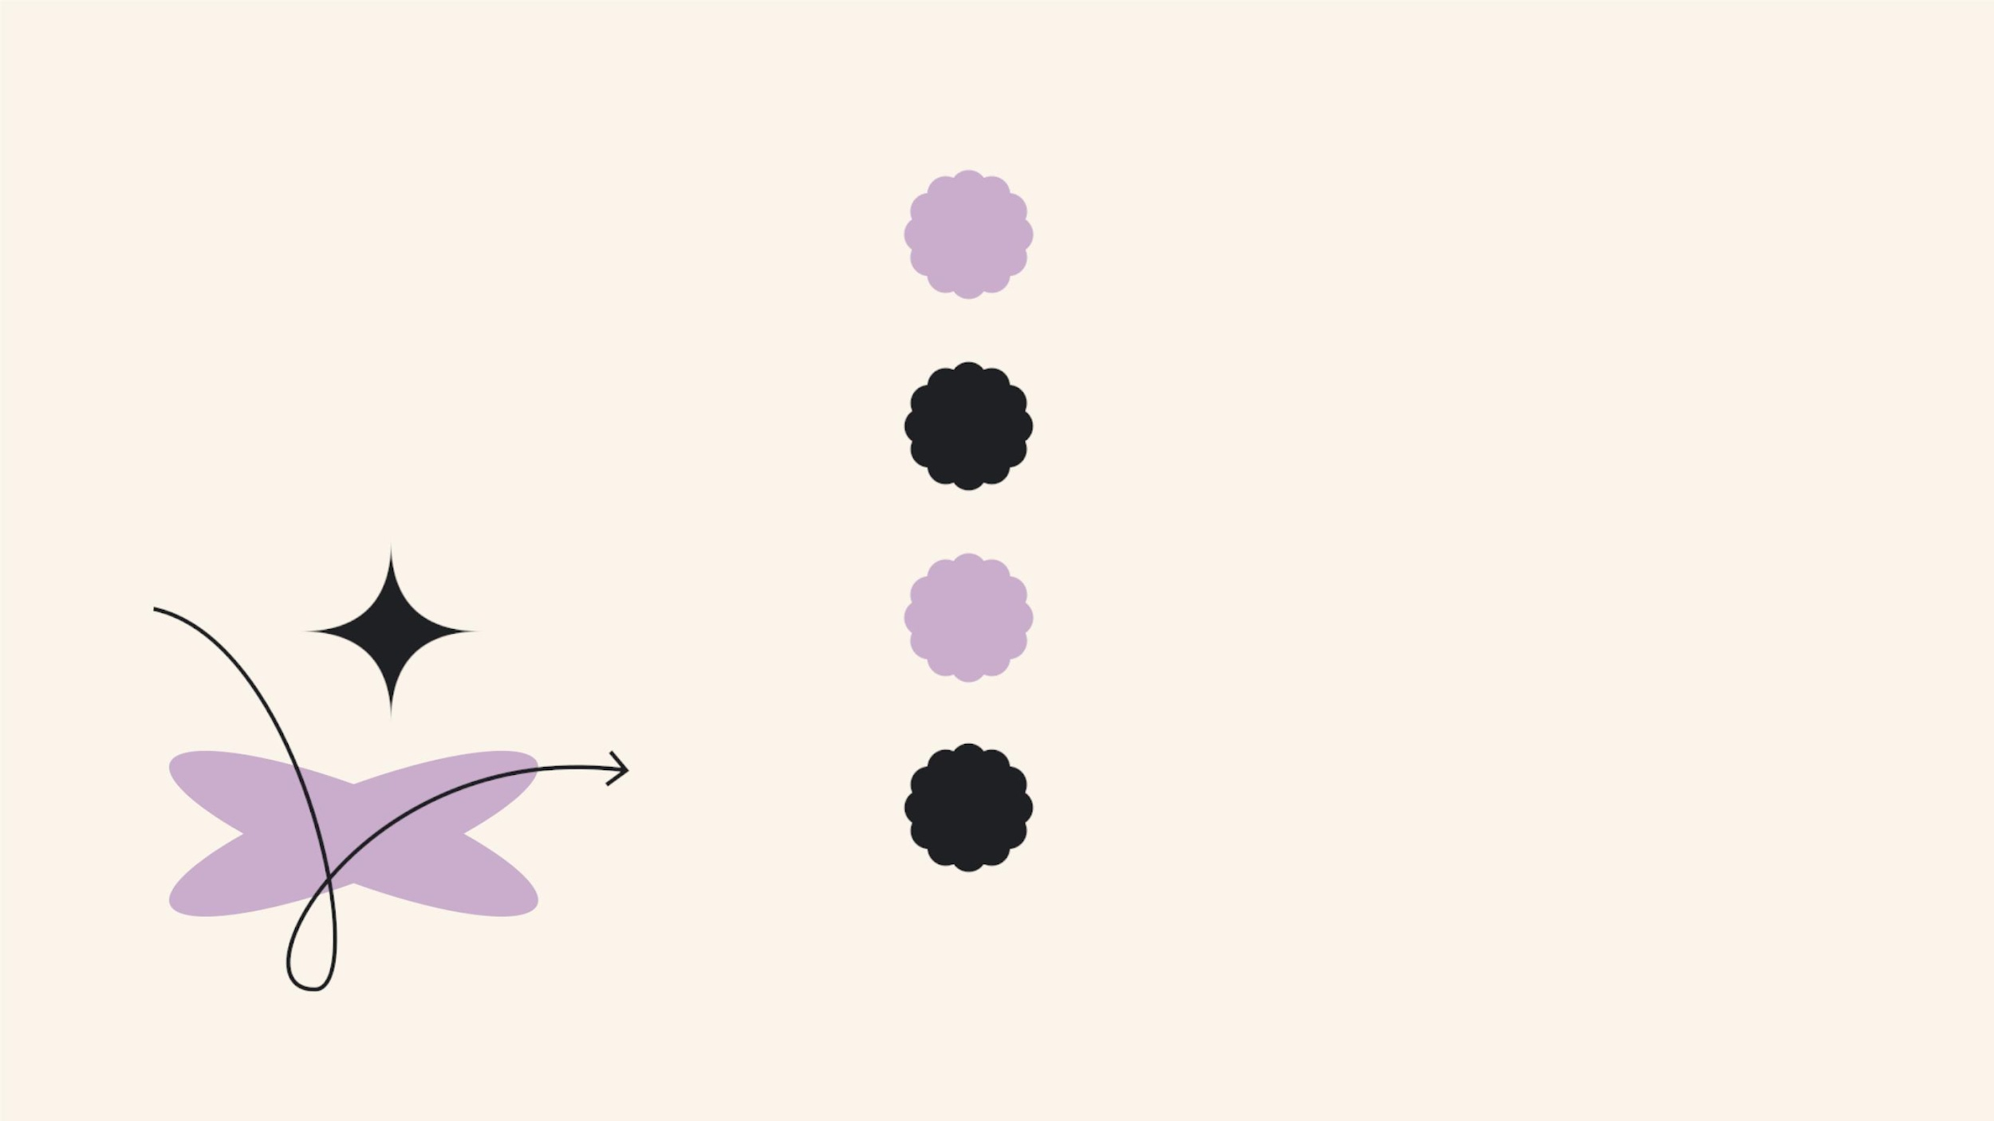
Data Collection
7
8
Sahel Precipitation - JISAO data
Sahel Land - SCIRP Journal
9
Niger Vegetation - AMMA-CATCH Dataset
Niger Precipitation - Climate Change Portal
10

Slide 7
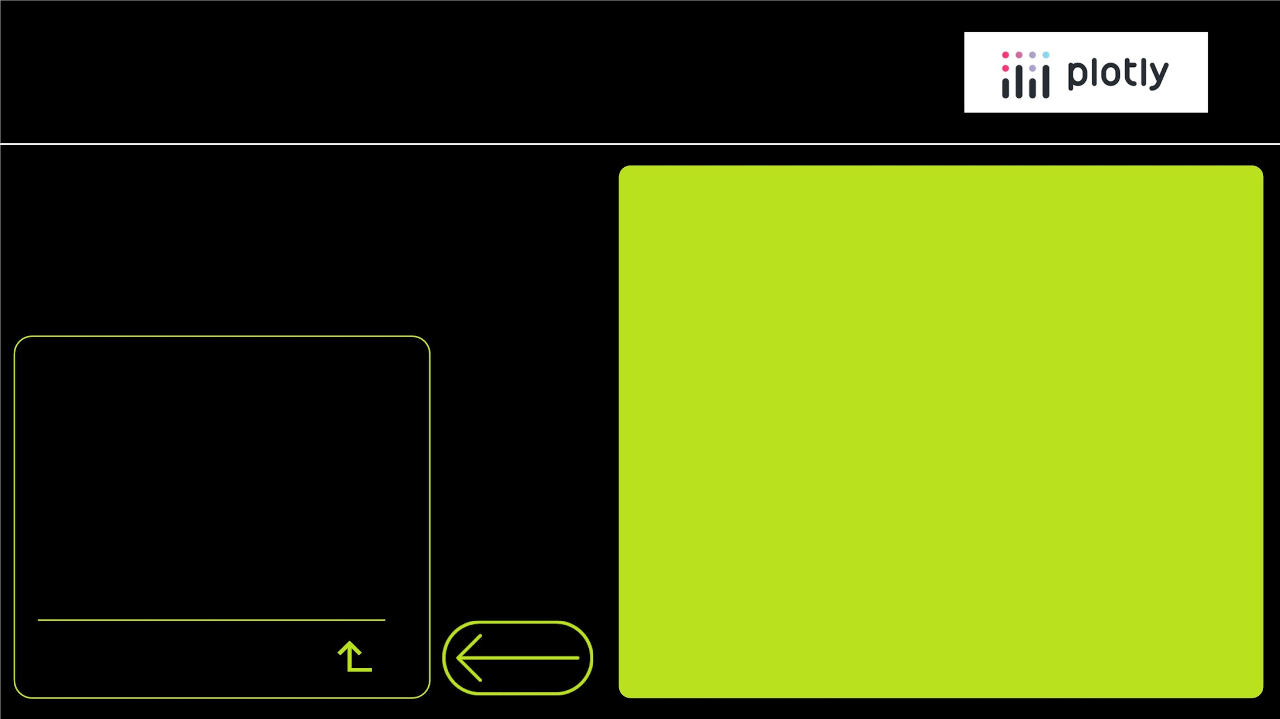
PLOTLY
Plotly is a powerful Python library
designed for creating interactive and
visually engaging data visualizations. This
open-source tool offers support for a
diverse array of chart types, boasting
more than 40 unique options. These charts
cater to a broad spectrum of applications,
spanning statistical analysis, financial
modeling, geographical mapping, scientific
research, and even three-dimensional
visualizations. Whether you need to
present complex data or explore intricate
datasets, Plotly equips you with the tools
to convey your insights effectively and
dynamically.
Our Project Includes
• Bar Graphs
• Line Graphs
Data Visualization

Slide 8
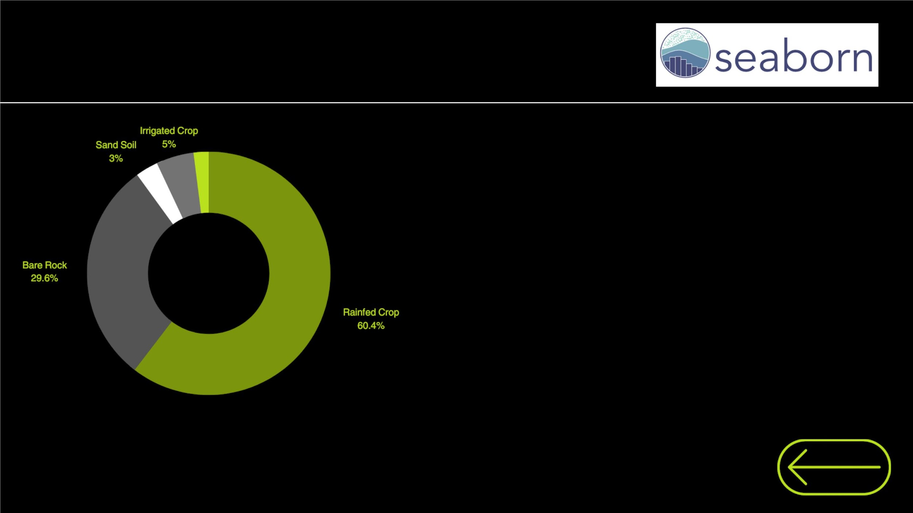
SeaBorn
Seaborn stands as a prominent Python
visualization library, built upon the foundatio
matplotlib. Its primary purpose is to offer a
level, user-friendly interface for crafting visu
appealing and insightful statistical graphics
seamlessly integrating with matplotlib, Seab
empowers data scientists and analysts to cr
sophisticated and informative data visualizat
with ease and precision, making it an indispens
tool in the data visualization toolkit
Our Project utilizes Pie-Charts from library

Slide 9
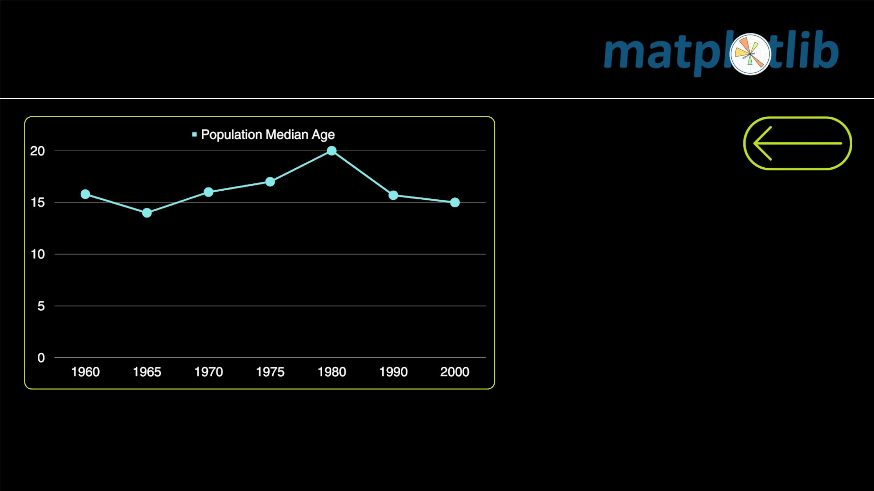
MATPLOTLIB
Matplotlib offers an array of featu
including support for various c
types (e.g., line, scatter, bar,
heatmap), customizable plots,
grained control over plot eleme
and compatibility with multiple
formats. It also allows for annota
3D plotting, and integration
Jupyter notebooks, making it
versatile tool for creating
quality data visualizations.

Slide 10
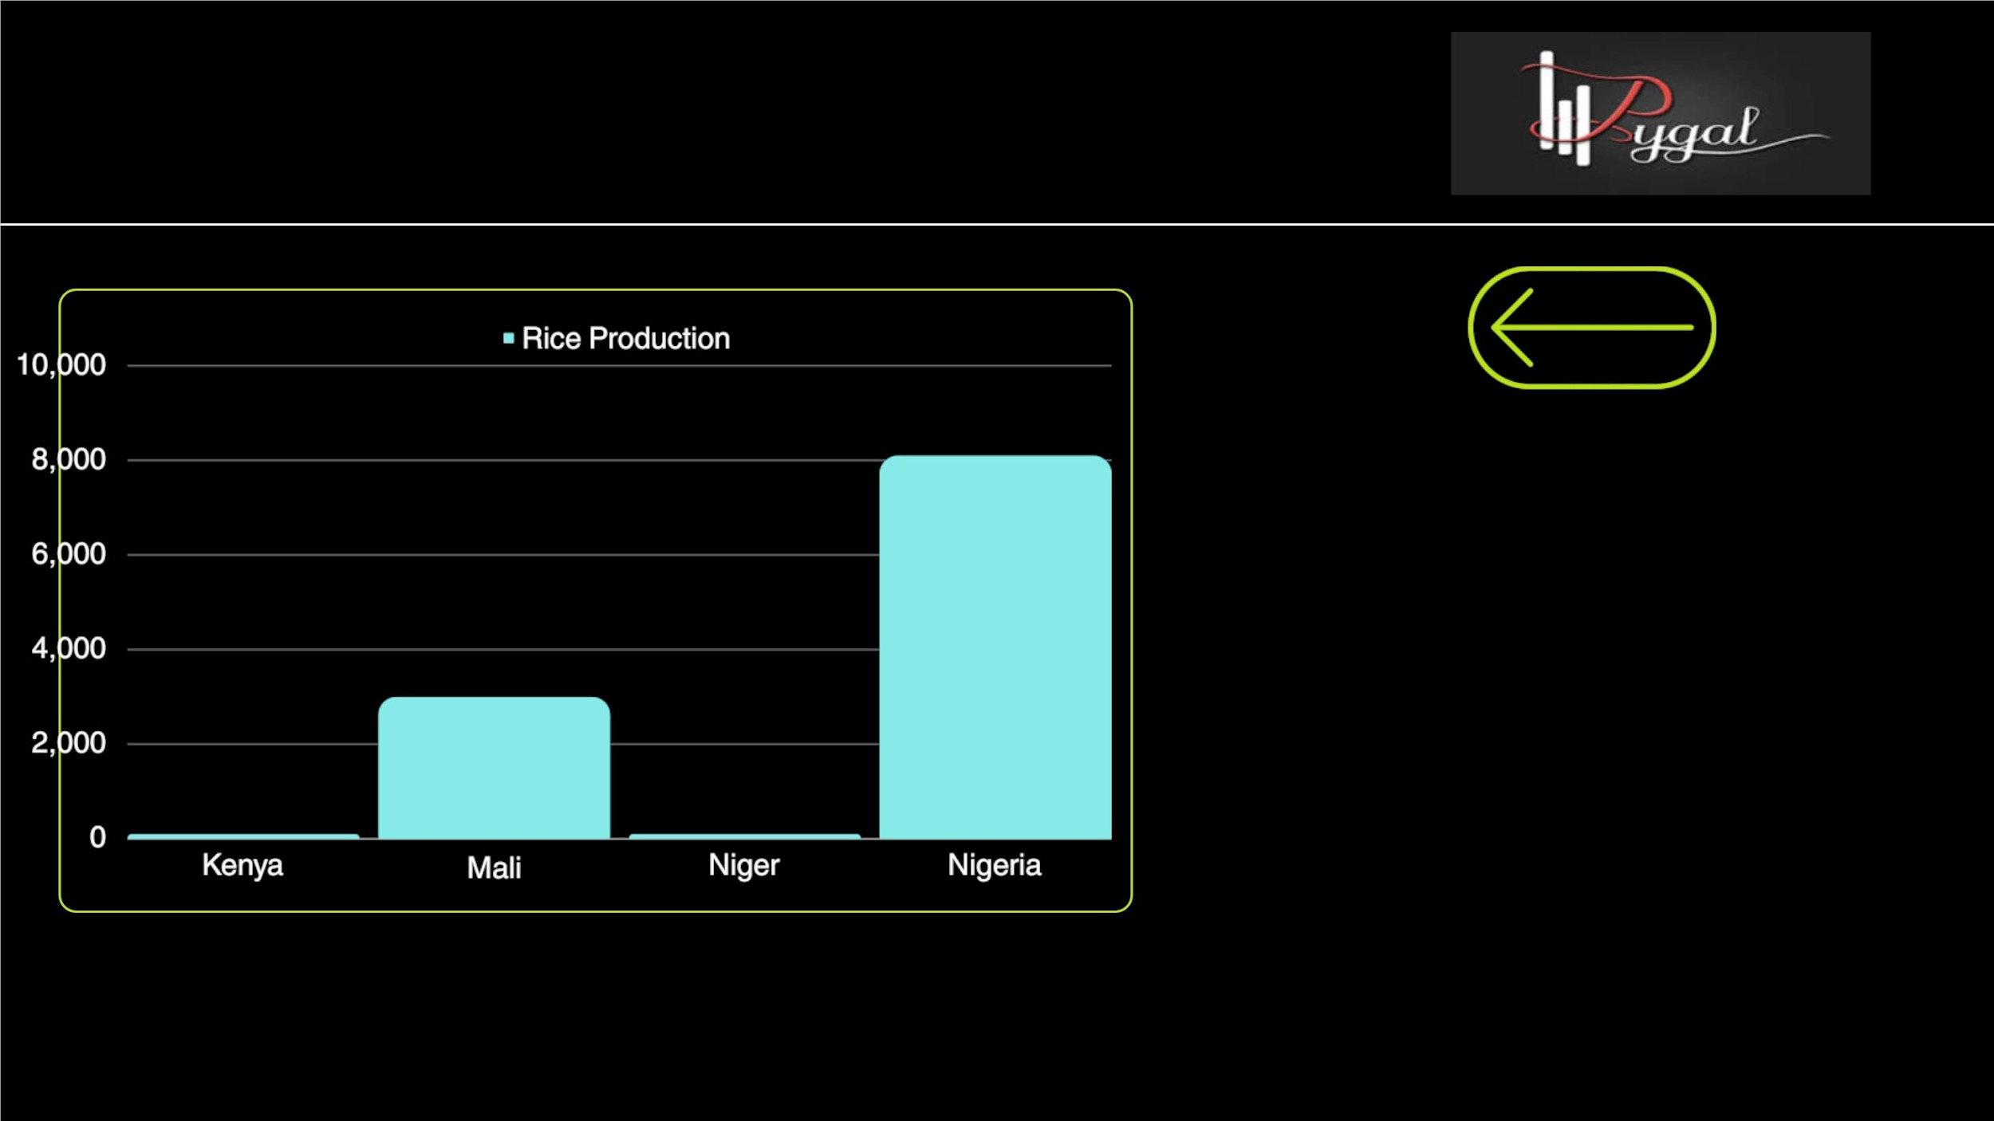
PYGAL
Pygal, a Python visualization libr
simplifies chart creation with
intuitive
interface,
emphasi
interactivity. Integrated seamle
with Python, it effortlessly gener
diverse charts like line, bar, and
graphs. Pygal's focus on simpl
empowers users to craft compel
visualizations, making it a valu
tool for data presentation
exploration in Python.

Slide 11
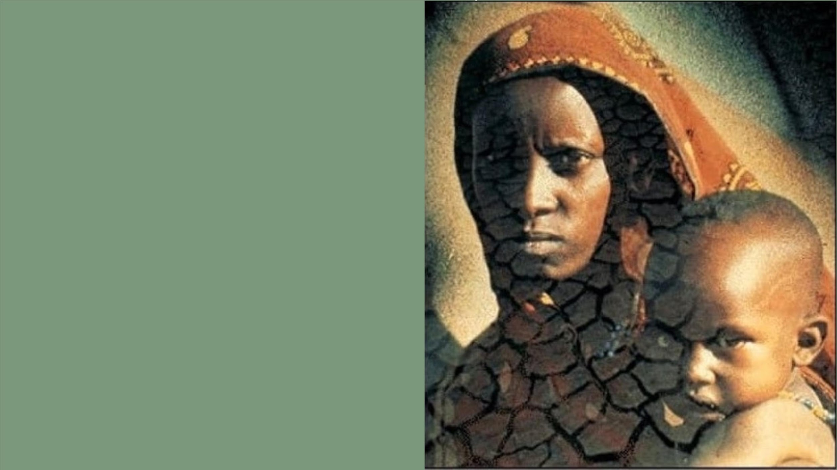
Case Study
Desertification in Sahel Region

Slide 12
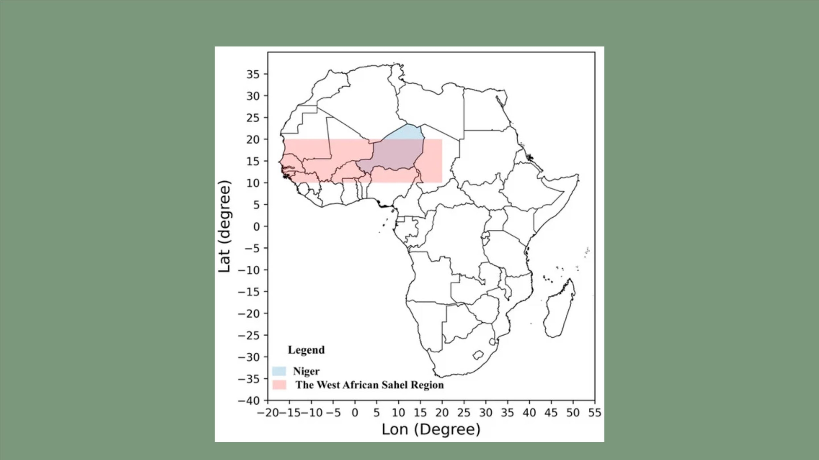
Sahel Region

Slide 13
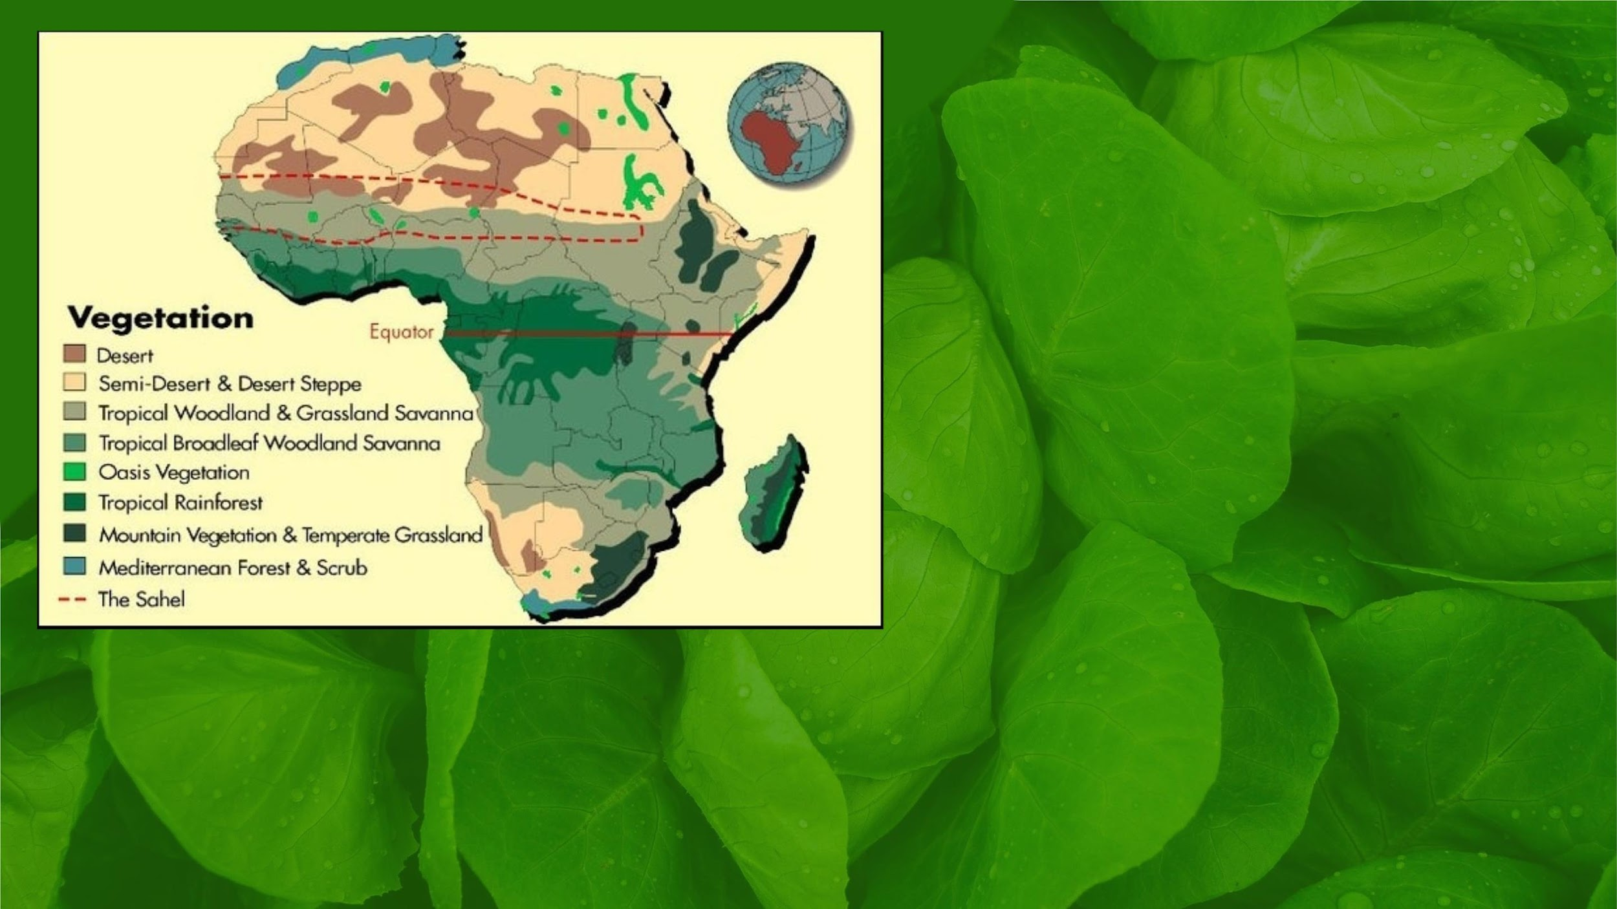

Slide 14
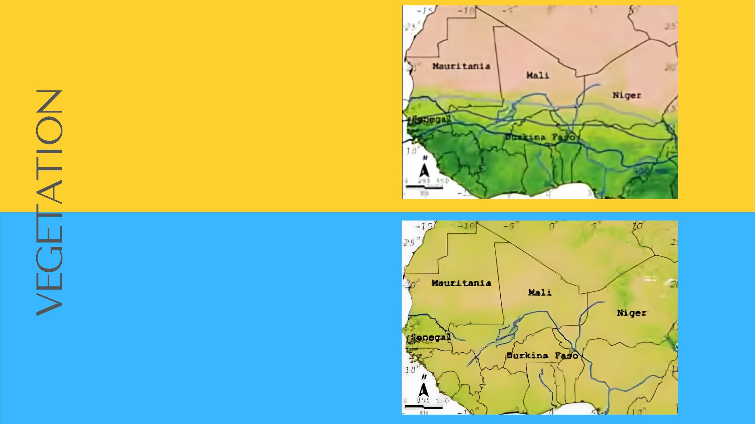
Average vegetation cover
[1982–2006] derived from
AVHRR satellite data at 8km
resolution.
Denser vegetation cover is
shown as dark green
Rain normalized vegetation
production 1982–2006 derived from
the ratio of annual vegetation
cover (AVHRR) to annual rainfall.
Rain normalized vegetation
production disentangles vegetation
changes caused by rainfall
variation from other factors.

Slide 15
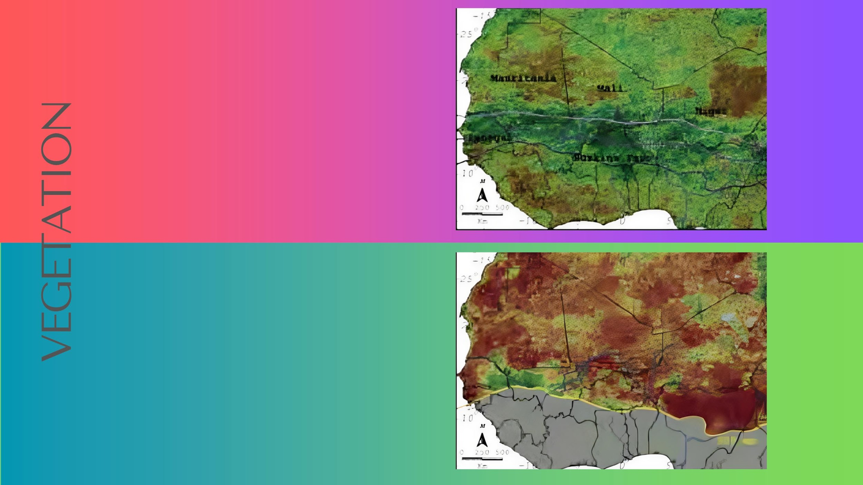
Greening and browning trends in
average vegetation cover 1982–
2006.
Absolute vegetation growth has
increased (green) in the Sahel
since the droughts in the 1980
Trends in rain normalized vegetation
production 1982–2006. Trends are shown
for areas with < 900 mm rainfall per
year.
Strong negative trends (brown) indicate
that the ability of the vegetation to
utilize available rainfall has
decreased in this time period

Slide 16
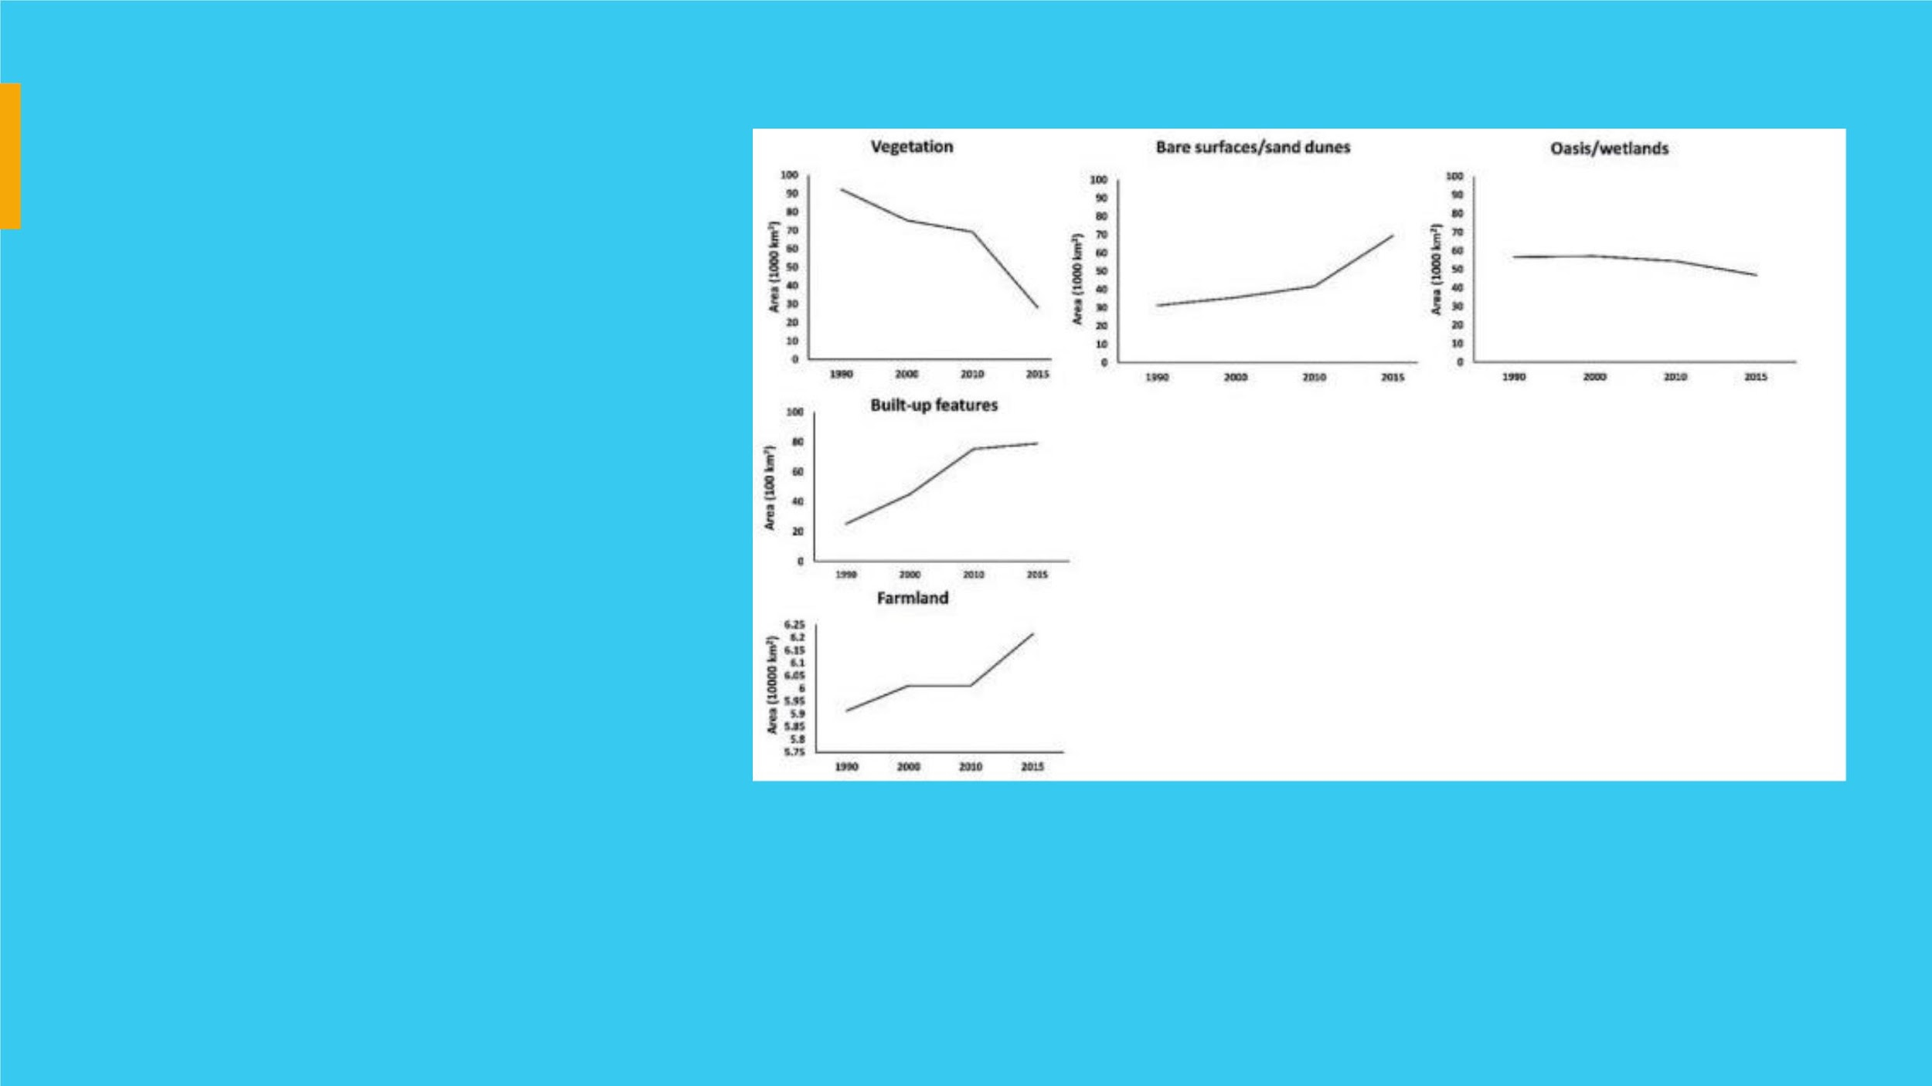
LANDꢀCOVER
• The start year demonstrates a low
concentration of built-up areas.
• By the year 2015, the built-up areas had
increased drastically to about 7893 ha.
• There was a steady decrease in
vegetation throughout the time slices
examined.
• A similar pattern of decline was
observed for the wetland and oasis
land cover class.
• FARMLAND REMAINS THE DOMINANT LAND
COVER IN STUDY AREA . IT HAS CONSISTENLTY
INCREASED THROUGHTOUT THE STUDY PERIOD
1990-2015

Slide 17
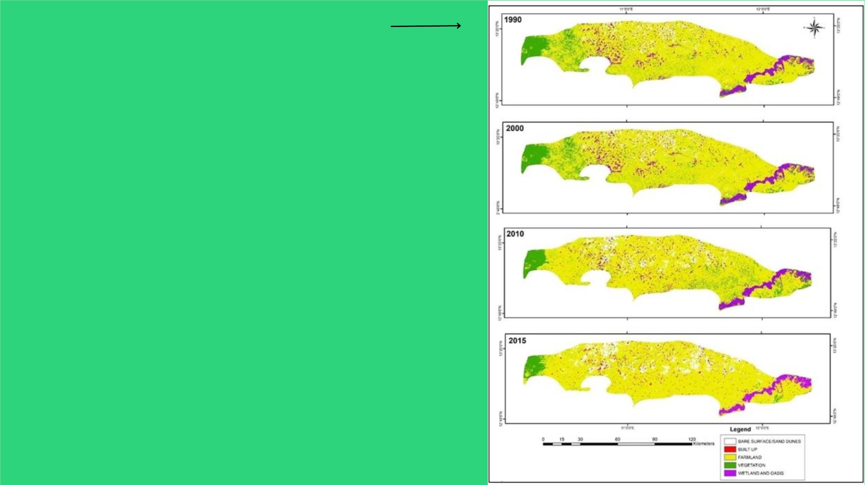
LANDꢀCOVERꢀMAPS
TRENDSꢀINꢀLANDꢀCOVERꢀCHANGE
• By the year 2015, the built-up areas had
increased drastically to about 7893 ha, which
is about 1% of the total land area.
• The rate of built-up expansion however
slowed down between 2010 and 2015. The
reverse was the case for vegetation. There
was a steady decrease in vegetation
throughout the time slices examined.
• In 1990, vegetation occupied about 11.9% of the
total area, with about 92,126 ha. This reduced
to 75,409 ha in 2000 (9.7% of the study area).
• There was even a further decrease in 2010
and 2015, with 69,120 ha in 2010, and only 28,143
ha in 2015, representing 8.9% and 3.6% of total
land, respectively

Slide 18
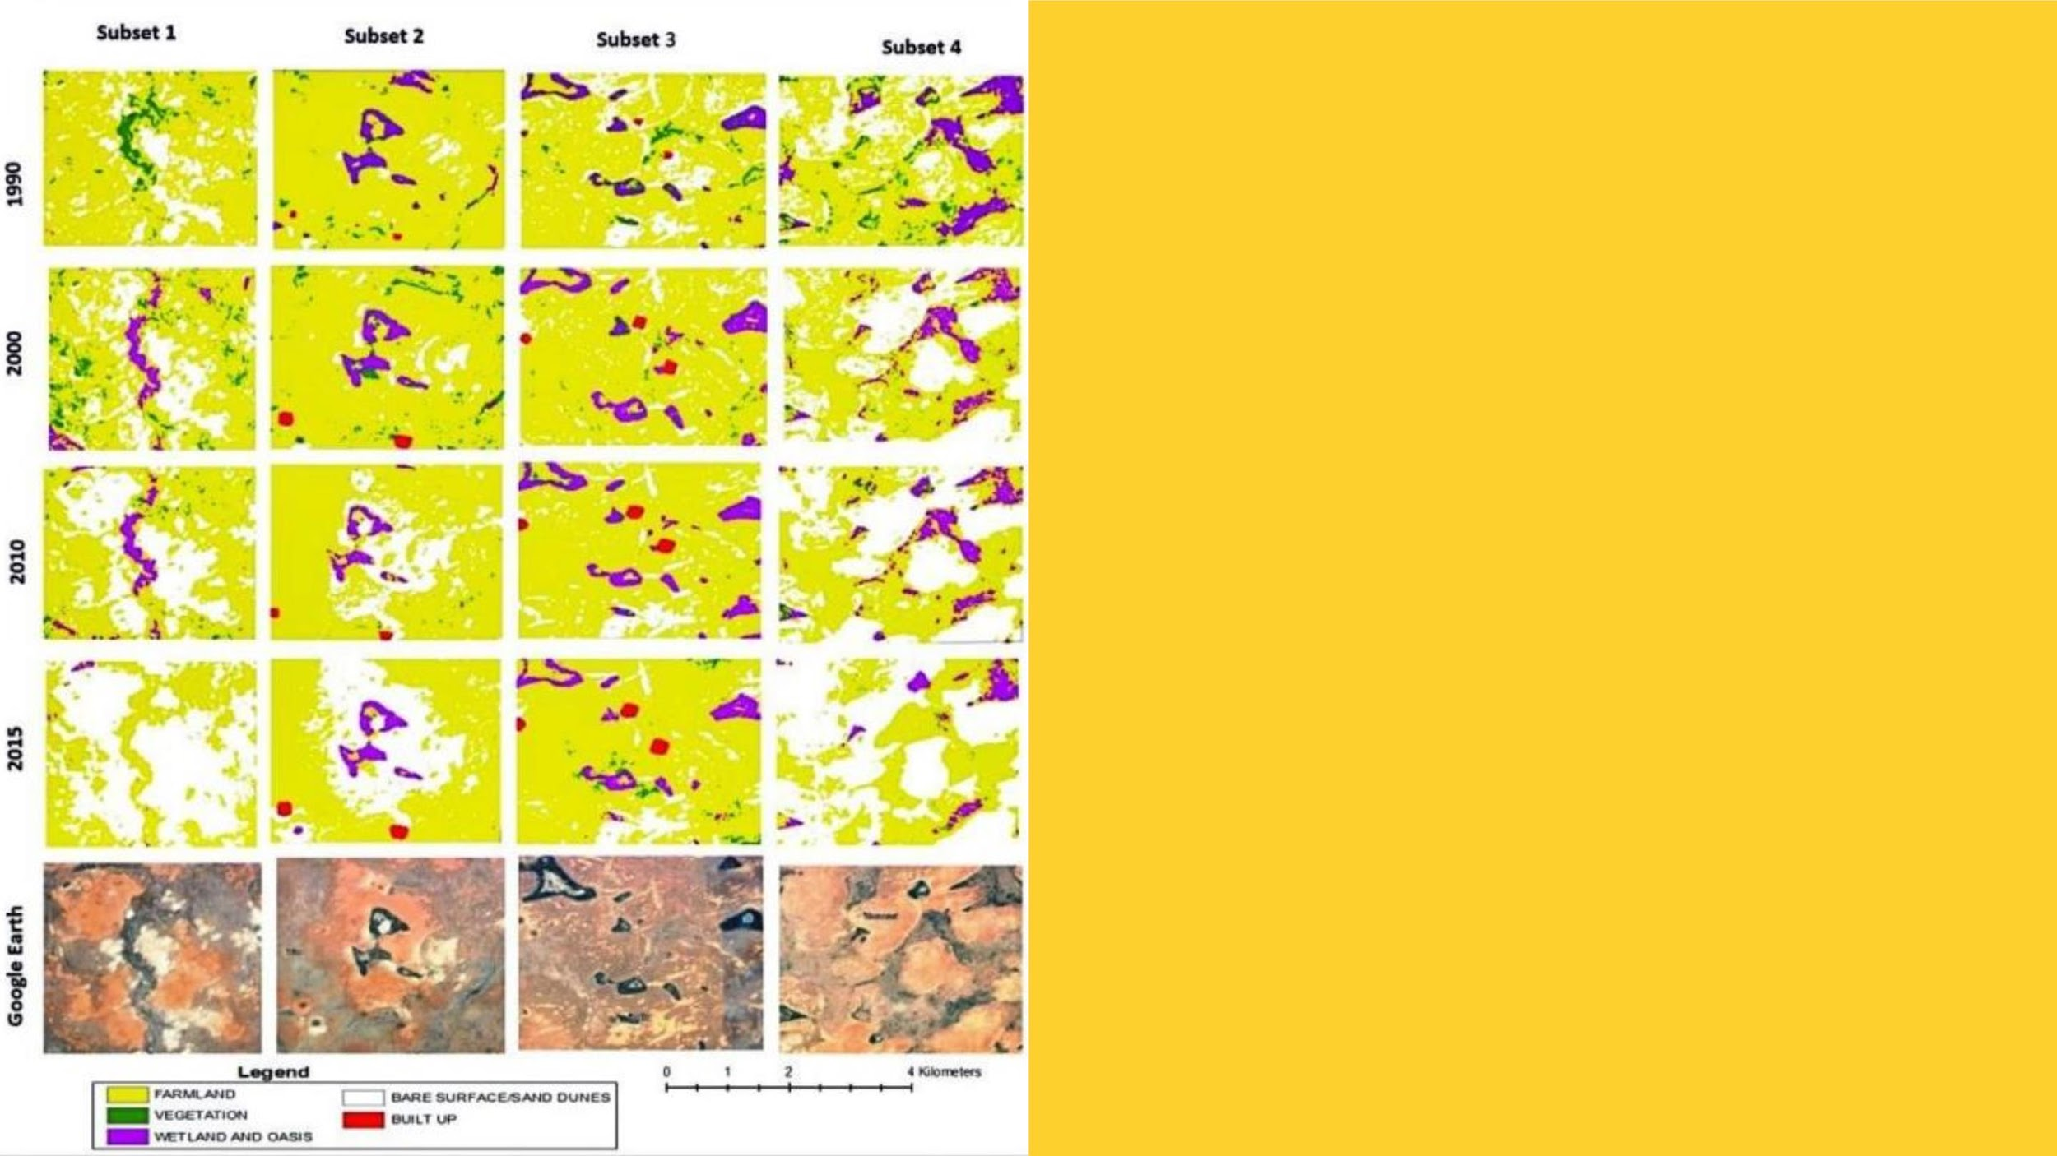
IMPACT ON SAND DUNE FEATURES
• Similarly Observed , was a substantial
advancement in sand dune features in
the study area.
• The figure shows various degrees of
sand dune progression in different
locations across the study area .
• On average , results reveal that the
sand dune in the study area is
progressing at a meAN annual rate of
1524 ha
• The Sand Dune Coverage Expanded from
4.1% to 9% of Total Landmass

Slide 19
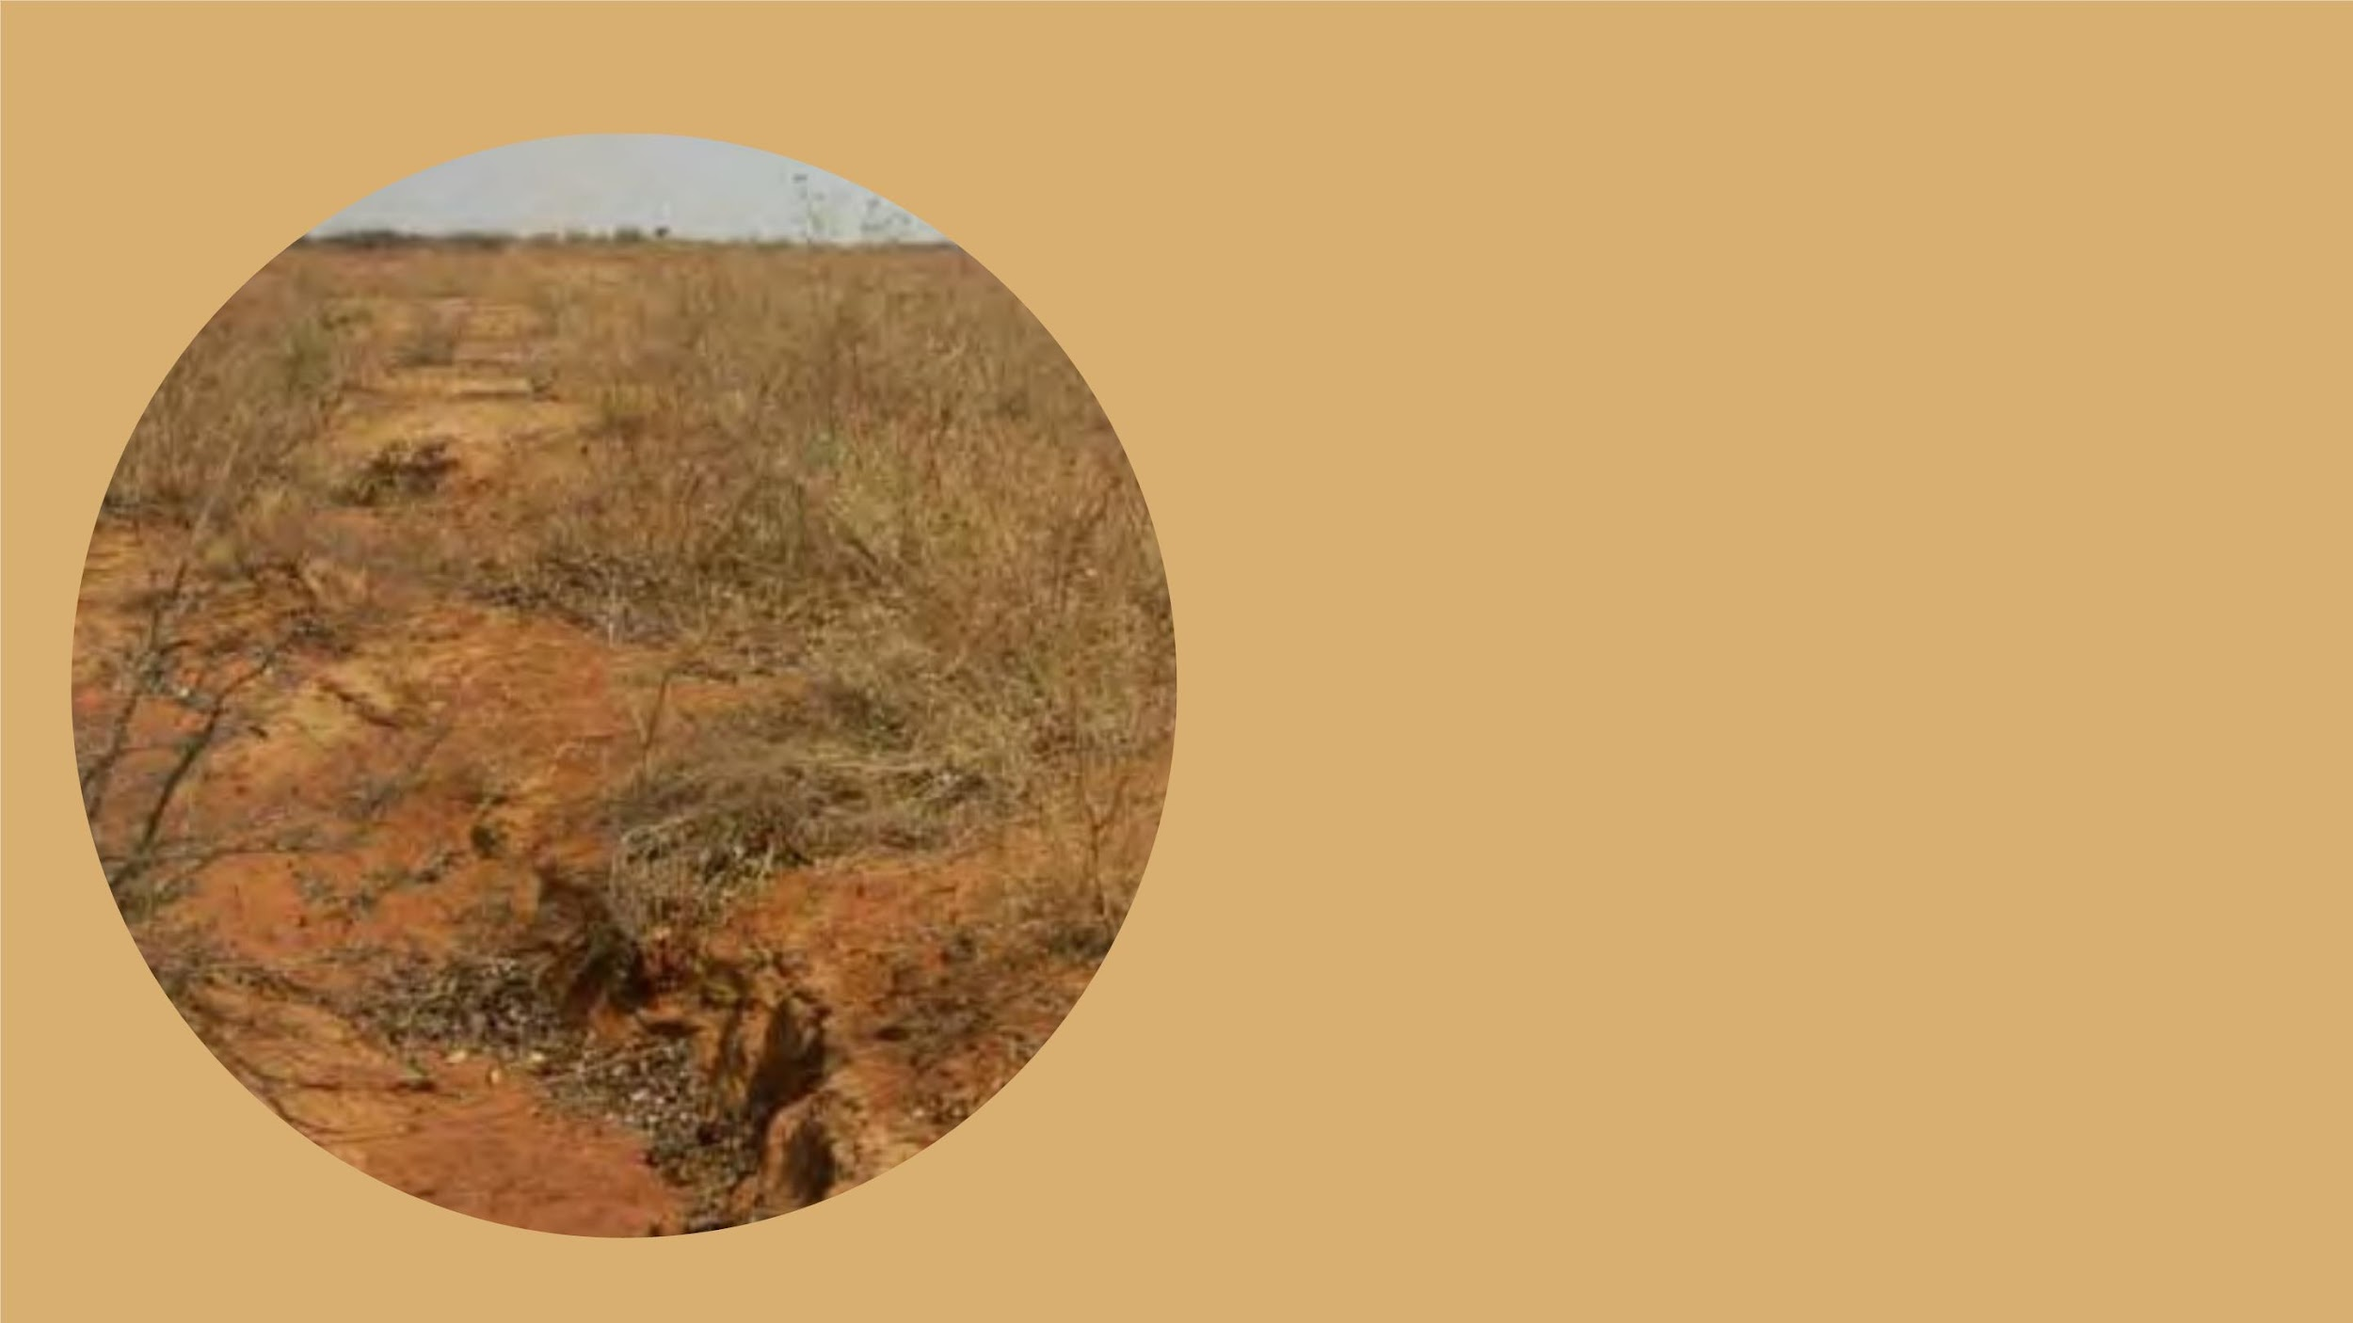
Land Degradation Hotspots
• Soil erosion by wind and water, soil physical
degradation (for example crust development)
and salinisation are important processes of soil
degradation in the Sahel, impoverishing soils
and decreasing food production.
• During the droughts in the 1970s and 1980s,
exposed soils were vulnerable to wind erosion,
and large areas lost their top soils.
• Analysis shows that vegetation recovery has not
been as strong as the increases in rainfall after
the droughts of the 1980s.
• This is indicated both by the rainfall front having
moved approximately twice as far north as the
vegetation front and that vegetation seems less
efficient in converting each drop of rainfall into
biomass. Vegetation is not responding fully to
increases in rainfall.

Slide 20

Climate and Precipitation

Slide 21
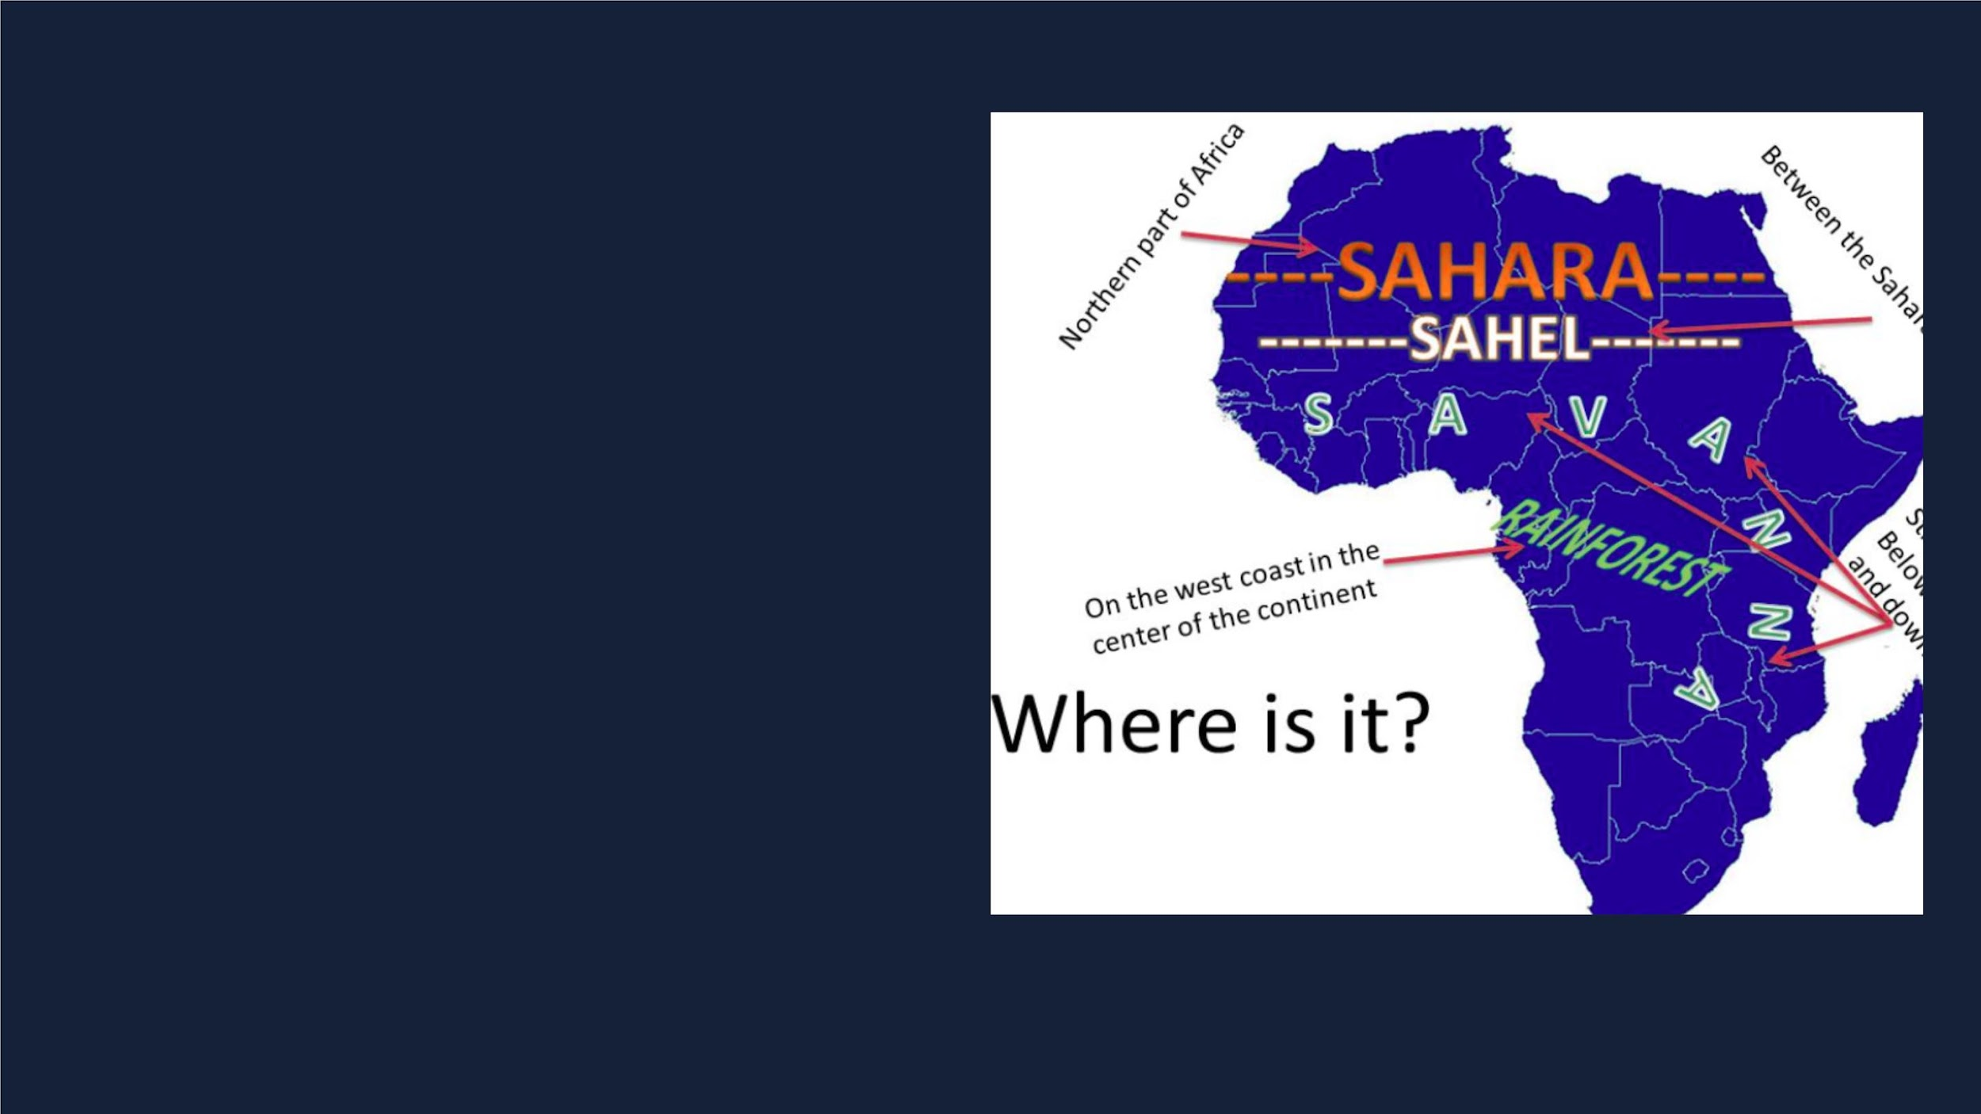
Sahel as mentioned
before is located
between the desert
region of Sahara and
the Savannas in the
South. So naturally it
has aN arid climate

Slide 22

ITF
The rainy season coincides with the arrival of the Intertropical Front (ITF), which is the
boundary between dry continental air and moist sea air. This collision creates
turbulence, leading to intense convective storms that often occur in the late afternoon.
Prior to the rain, there are violent sandstorms, and sometimes the rain doesn't reach
the ground. As the ITF moves north, the 'monsoon' arrives, bringing humid winds from
the southwest. Conversely, when the ITF retreats southward, it brings the dry
harmattan, a northeast wind. Rainfall is closely linked to the unpredictable movement
of the ITF. Early advances, temporary retreats, and late returns of the ITF can result in
uneven rainfall distribution, negatively impacting vegetation.

Slide 23
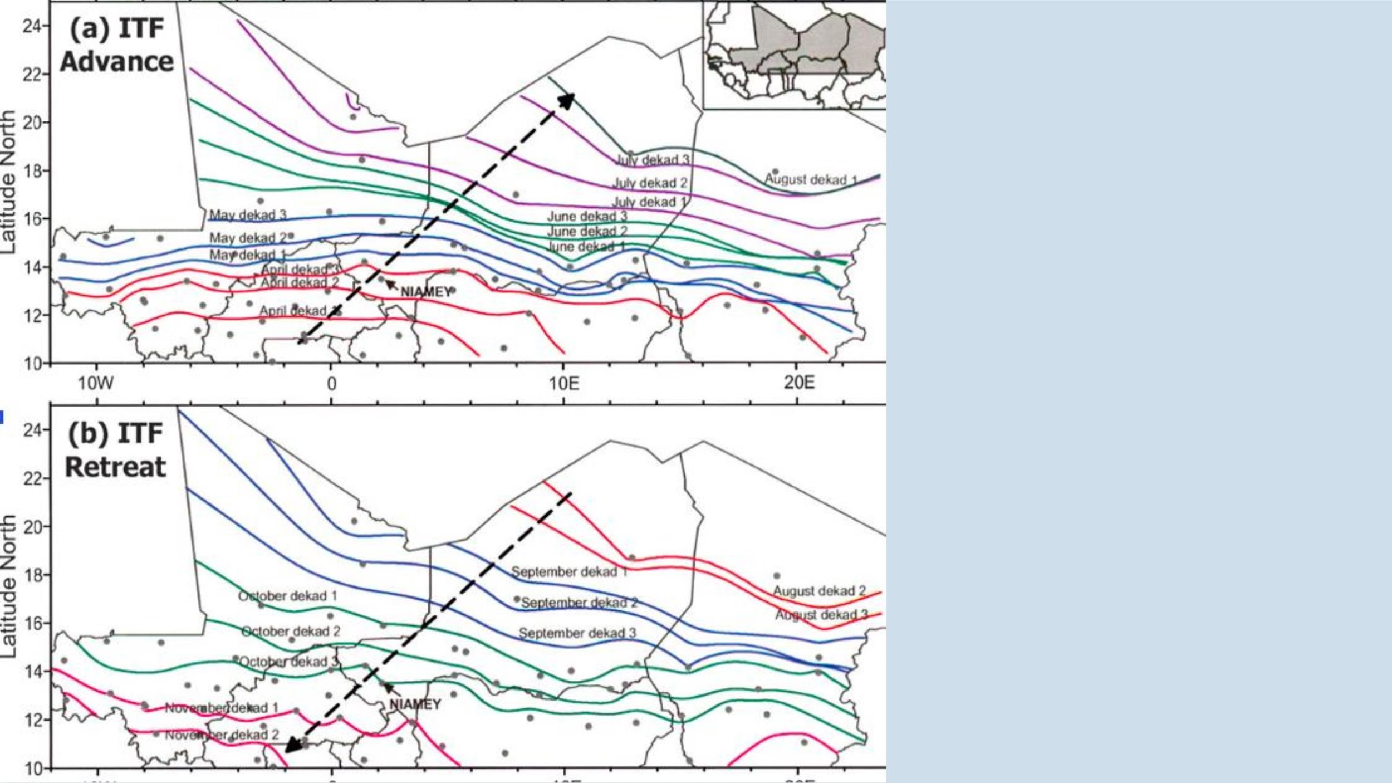
ROUTE
FOLLOWED BY
ITF IN SAHEL
REGION

Slide 24
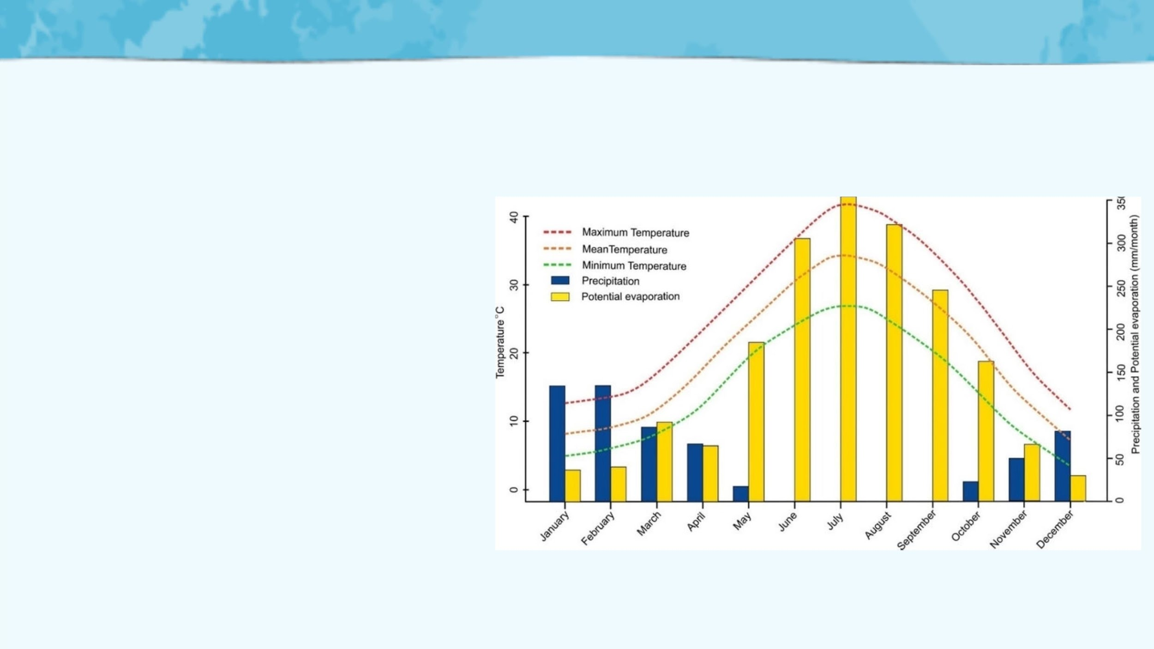
EVAPORATION AND TEMPERATURE
Evaporation is a crucial factor in the life of the North
Sahel region as it leads to the drying of plants and
pools. The rates of evaporation reach their peak
during the scorching dry months of March to May,
decline in the subsequent months, and then rise
again starting from November.
Evaporation levels are influenced by both wind and
temperature, with temperature being the primary
factor. The months with the highest temperatures,
typically from March to June, experience the
greatest evaporation rates.
Moreover the presence of great heat and
evaporation can be hard on people who often have
heavy work to do at this time.

Slide 25

PRECIPITATION
Precipitation occurs when water
falls back to earth. This can
happen in the form of rain, hail,
sleet and snow.
Rainfall plays a central role in arid
regions as it directly influences
vegetation, surface water, and
shallow groundwater. Rainfall in Sahel
can be best classified as irregular.
Irregularities are of 2 types
• Irregular distributed within one
cycle
• Variation in rainfall from one year
to other

Slide 26

IRREGULARITIES WITHIN ONE CYCLE
• Useful rainfall is the % of rain that helps in vegetation development
by triggering germination
• Abnormal rainfall timing can eliminate many annual species, making
perennial plants more dominant. However, persistent irregularity
depletes the reserves of perennial plants as well.
• For example, there was lesser than average rainfall in 1967 but it was
evenly spread throughout the monsoon season and there was no
drought.
• 1968 had above average rainfall but majority of the rainfall was in the
first few days, which triggered germination but these plants were left
without subsequent rainfall causing their death.

Slide 27
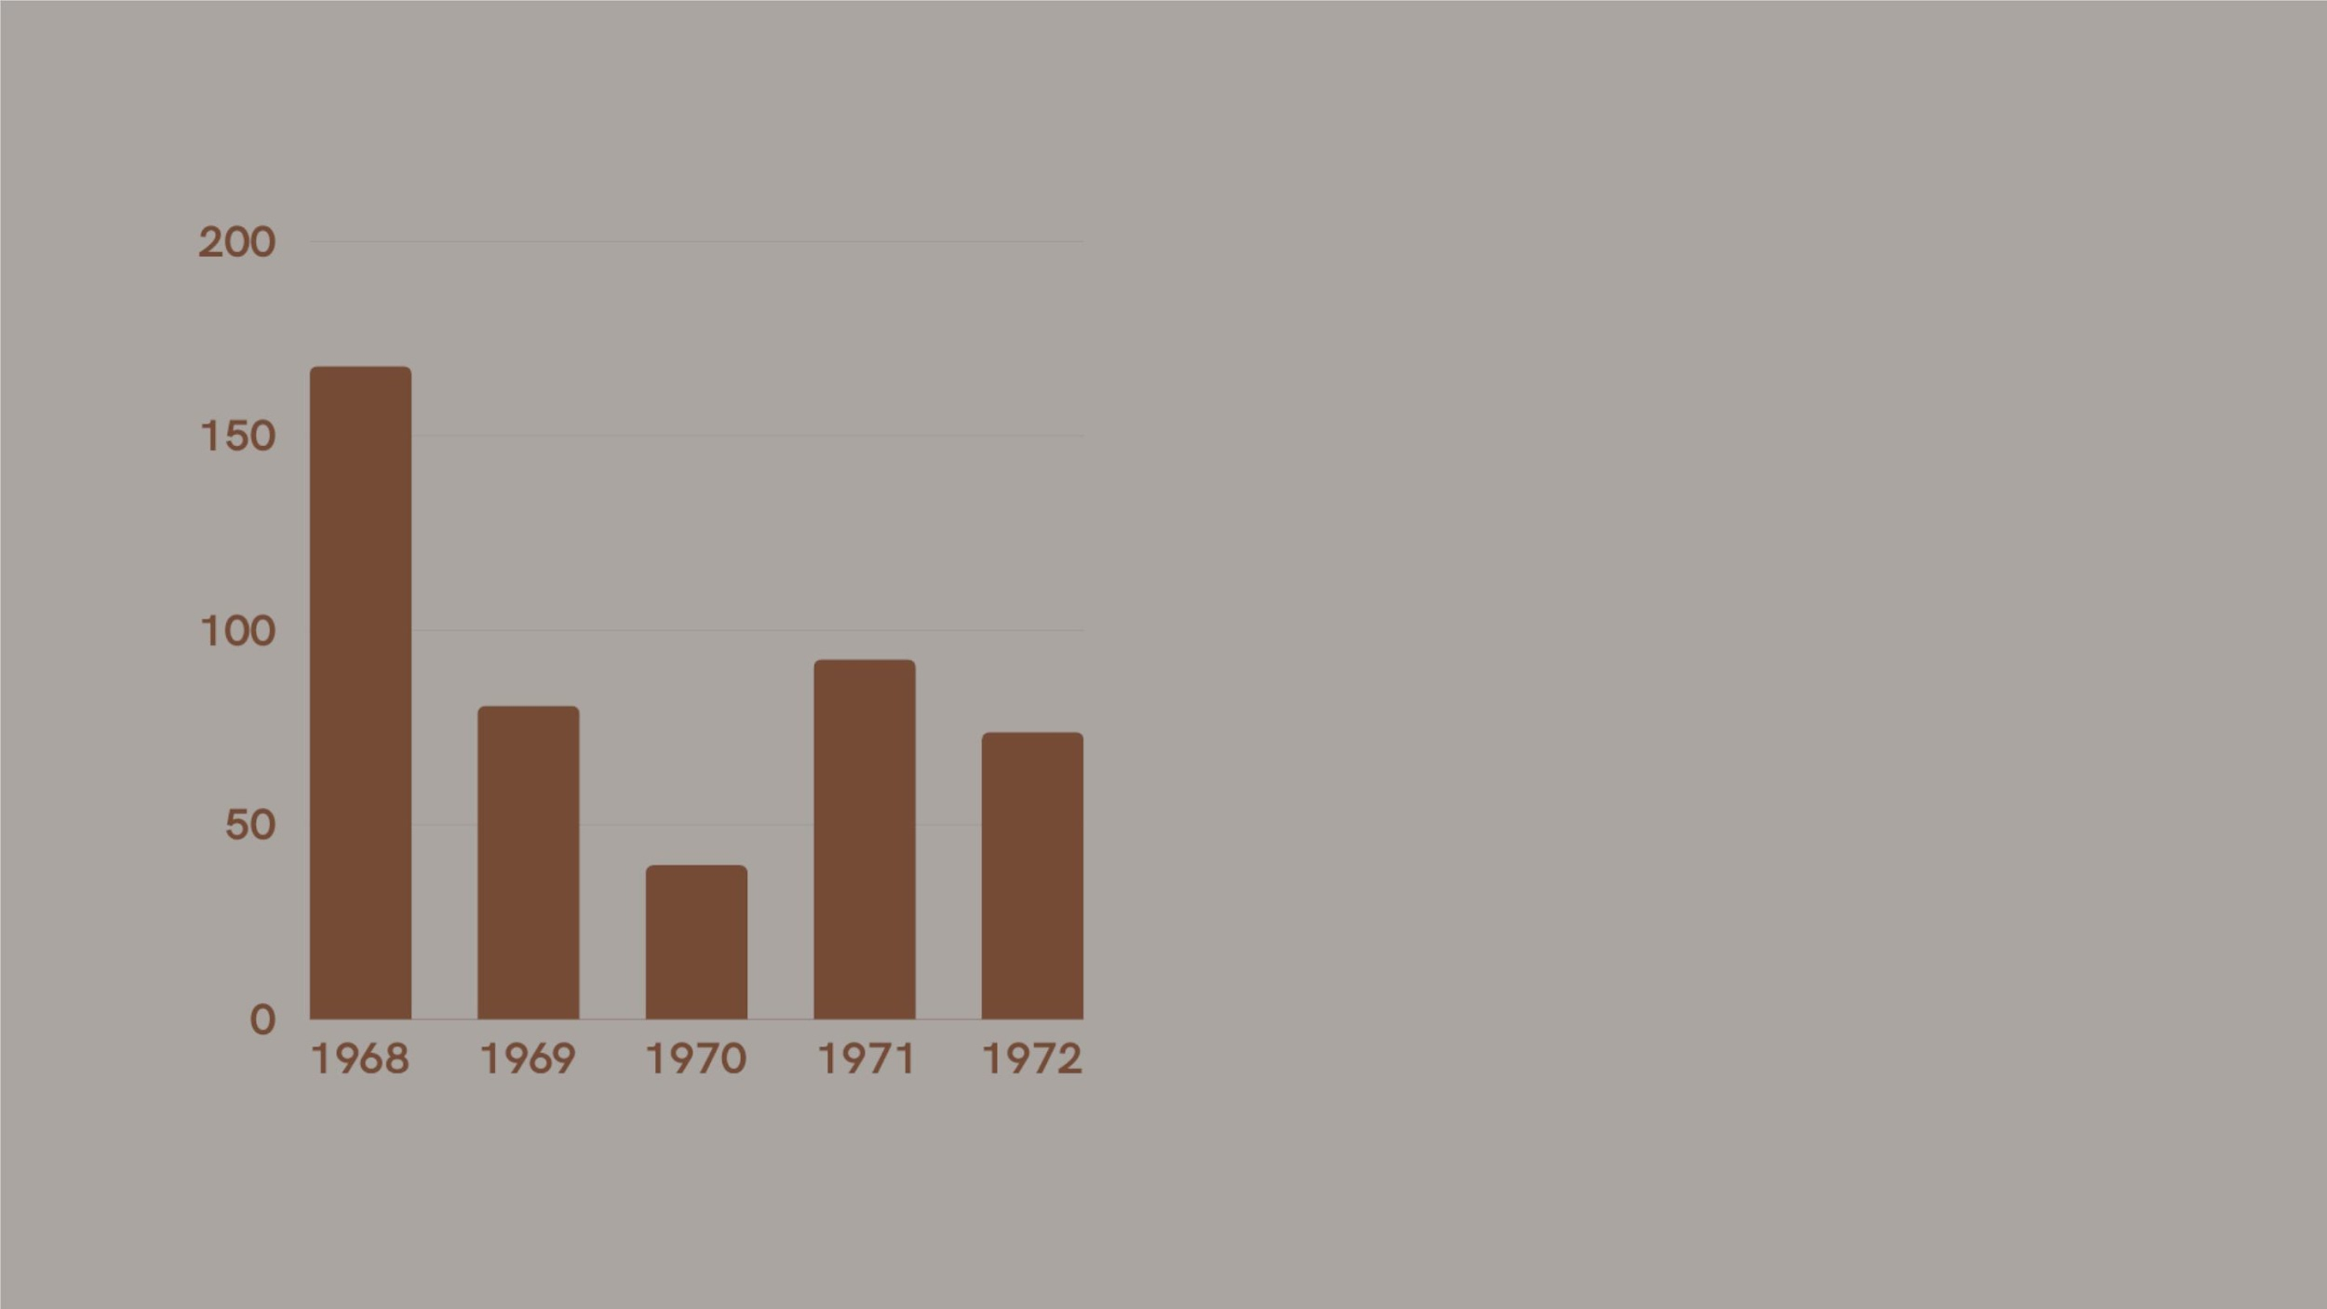
INTERANNUAL
IRREGULARITY IN
RAINFALL
The interannuailrregularitycan often producerainfall
shortagesover a seriesof successiveyearsas was the
casefrom1969 to 1972.The cumulativeeffectof these
years caused droughts of catastrophic proportions.

Slide 28
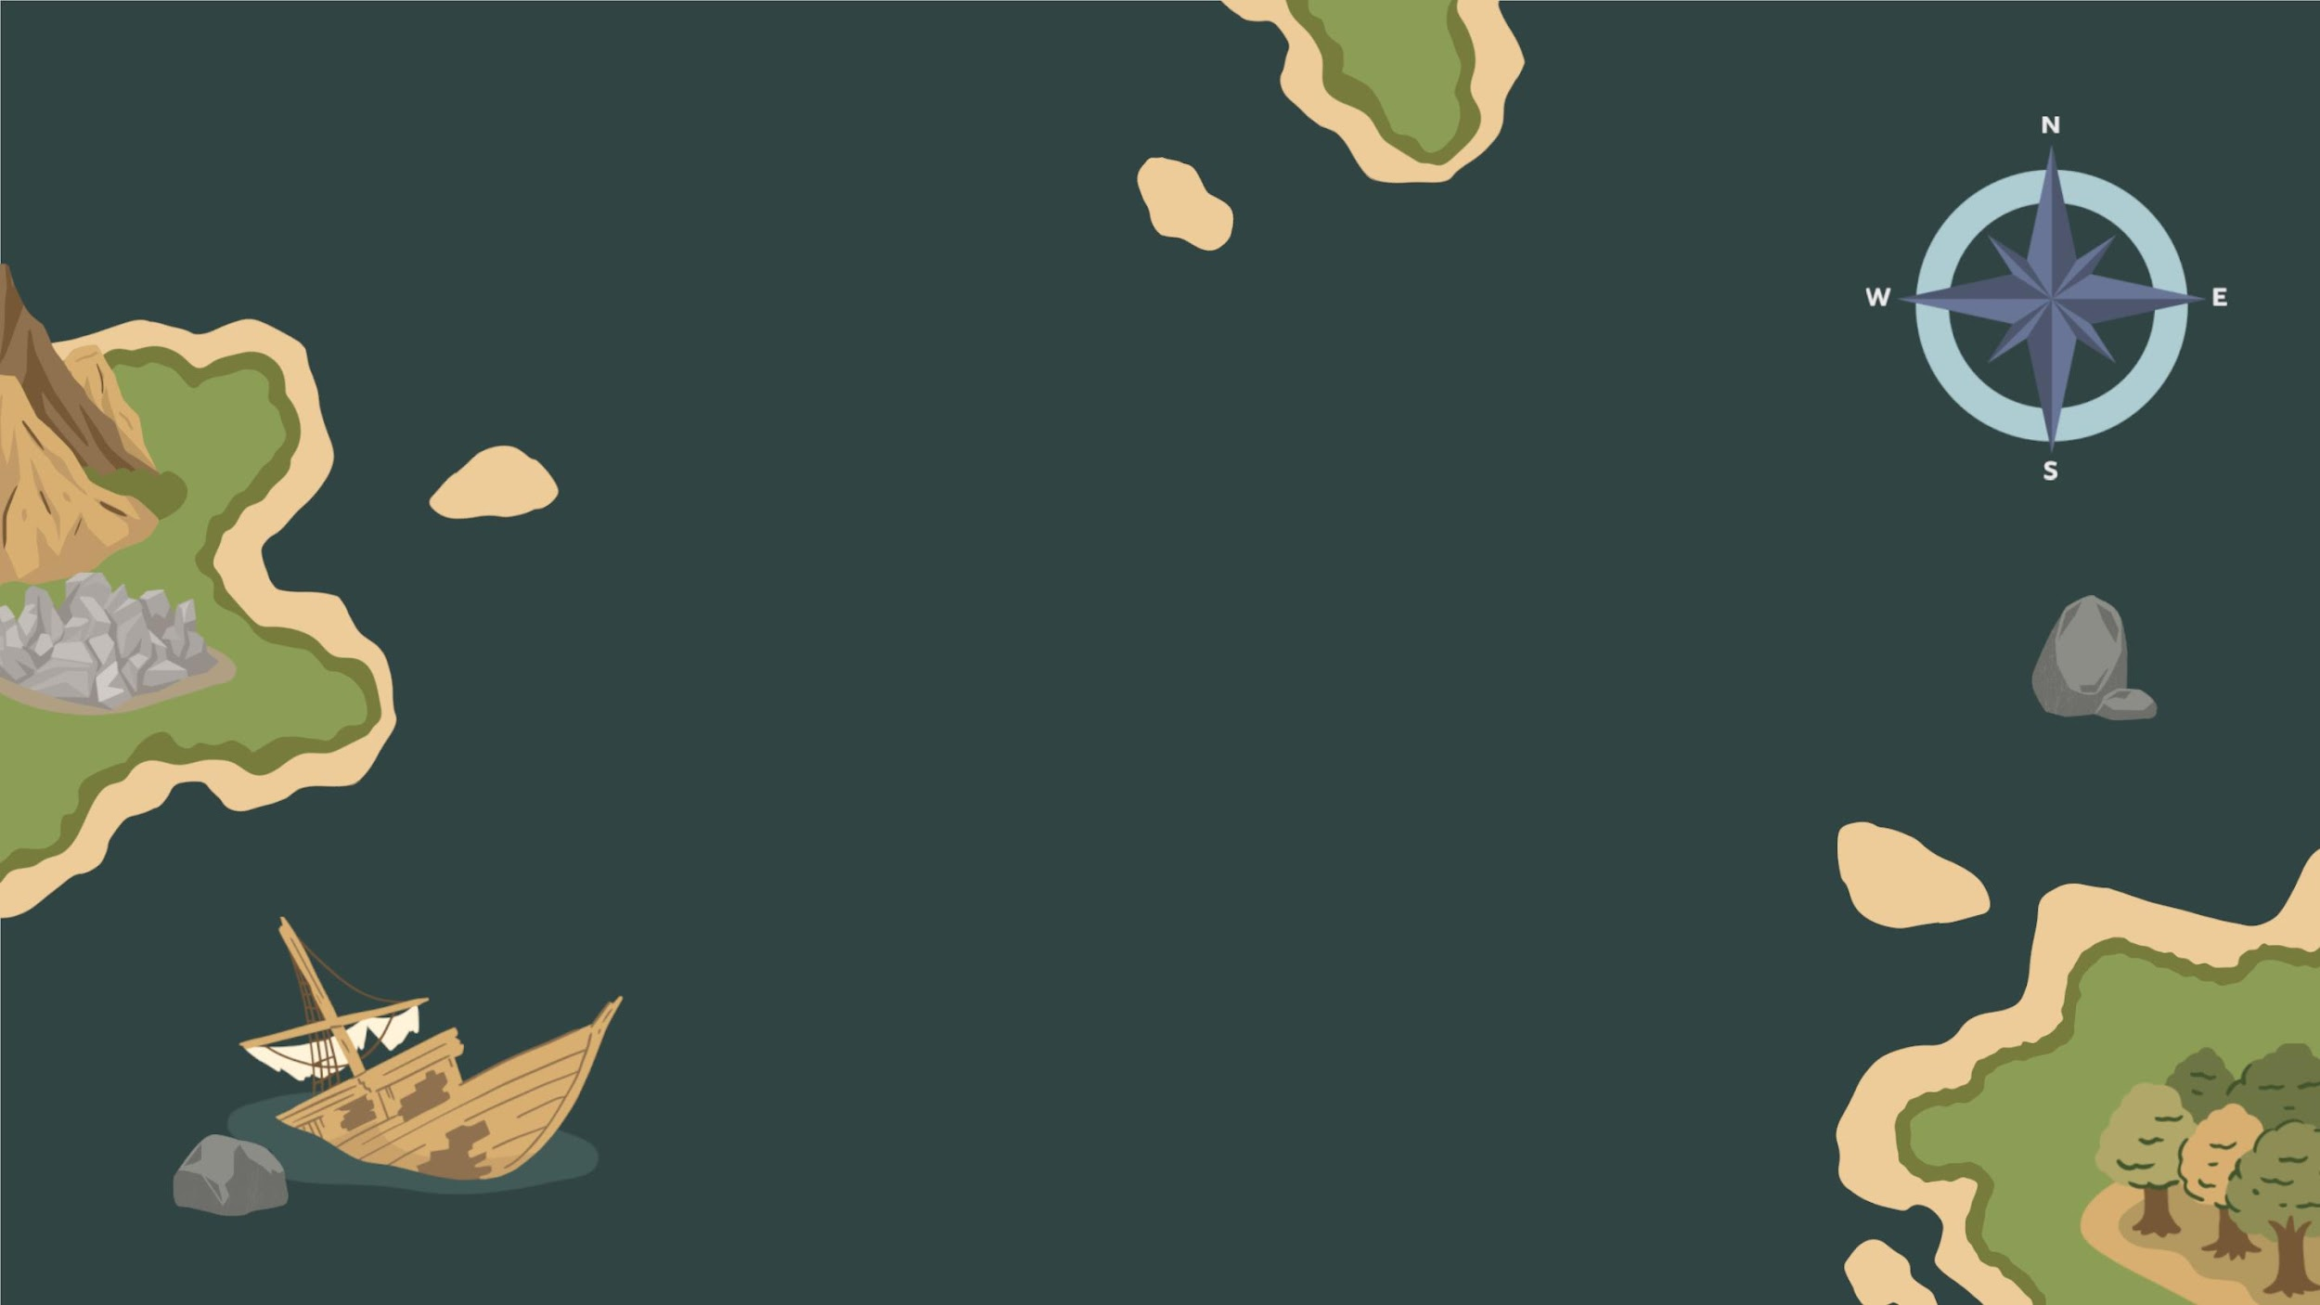
Population
and
Demographics

Slide 29

Why is it important to learn
about Population and
Demographics?
• Population growth and demographic factors
intimately linked to desertification
• Sahel’s fragile ecosystems degraded due to
unsustainable land-usage and exacerbated water
stress due to soaring population
• This analysis provides valuable information to
enable us in developing effective strategies to
combat desertification

Slide 30
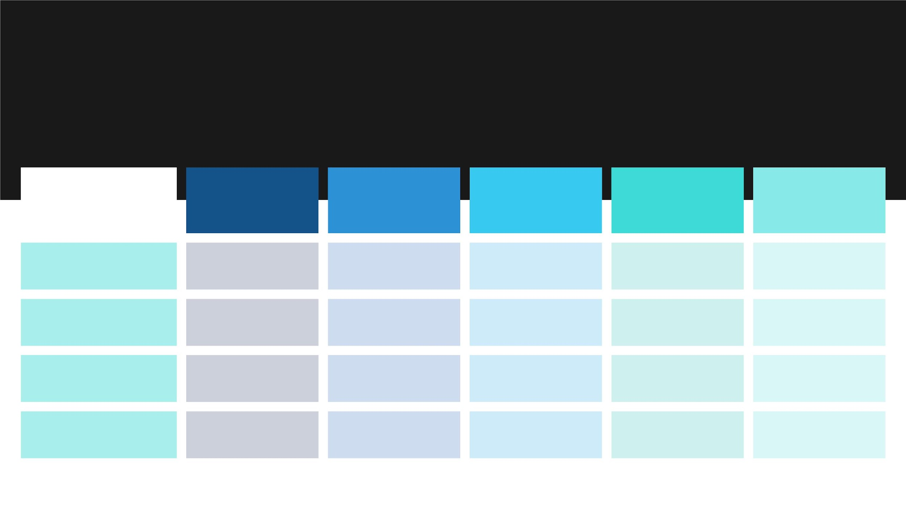
Population Growth Trends
In West Africa
FERTILITY
RATE
LIFE
EXPECTANCY
INFANT
MORTALITY
HDI RANKING
AVERAGE AN
POPULATI
GROWTH IN L
YEARS
COUNTRY
Niger
6.95
5.23
4.65
4.51
61.8
60.9
67.5
57.8
102
84
189
183
164
177
3.23%
2.84%
Burkina Faso
Senegal
45
1.86%
3.02%
Guinea-Bissau
82

Slide 31

What role did the resource
demand play in causing
desertification in the Sahel ?
Resource
Demands
• Aꢀrapidlyꢀgrowingꢀpopulationꢀrequiresꢀ
moreꢀfood,ꢀwater,ꢀandꢀshelter.
• Toꢀmeetꢀtheseꢀneeds,ꢀpeopleꢀinꢀtheꢀ
Sahelꢀengageꢀinꢀagriculturalꢀactivities,ꢀ
oftenꢀemployingꢀunsustainableꢀ
practicesꢀthatꢀleadꢀtoꢀlandꢀdegradation.
• Overgrazing,ꢀexcessiveꢀlandꢀcultivation,ꢀ
andꢀinadequateꢀirrigationꢀmethodsꢀareꢀ
someꢀofꢀtheꢀconsequencesꢀofꢀ
populationꢀpressure.

Slide 32
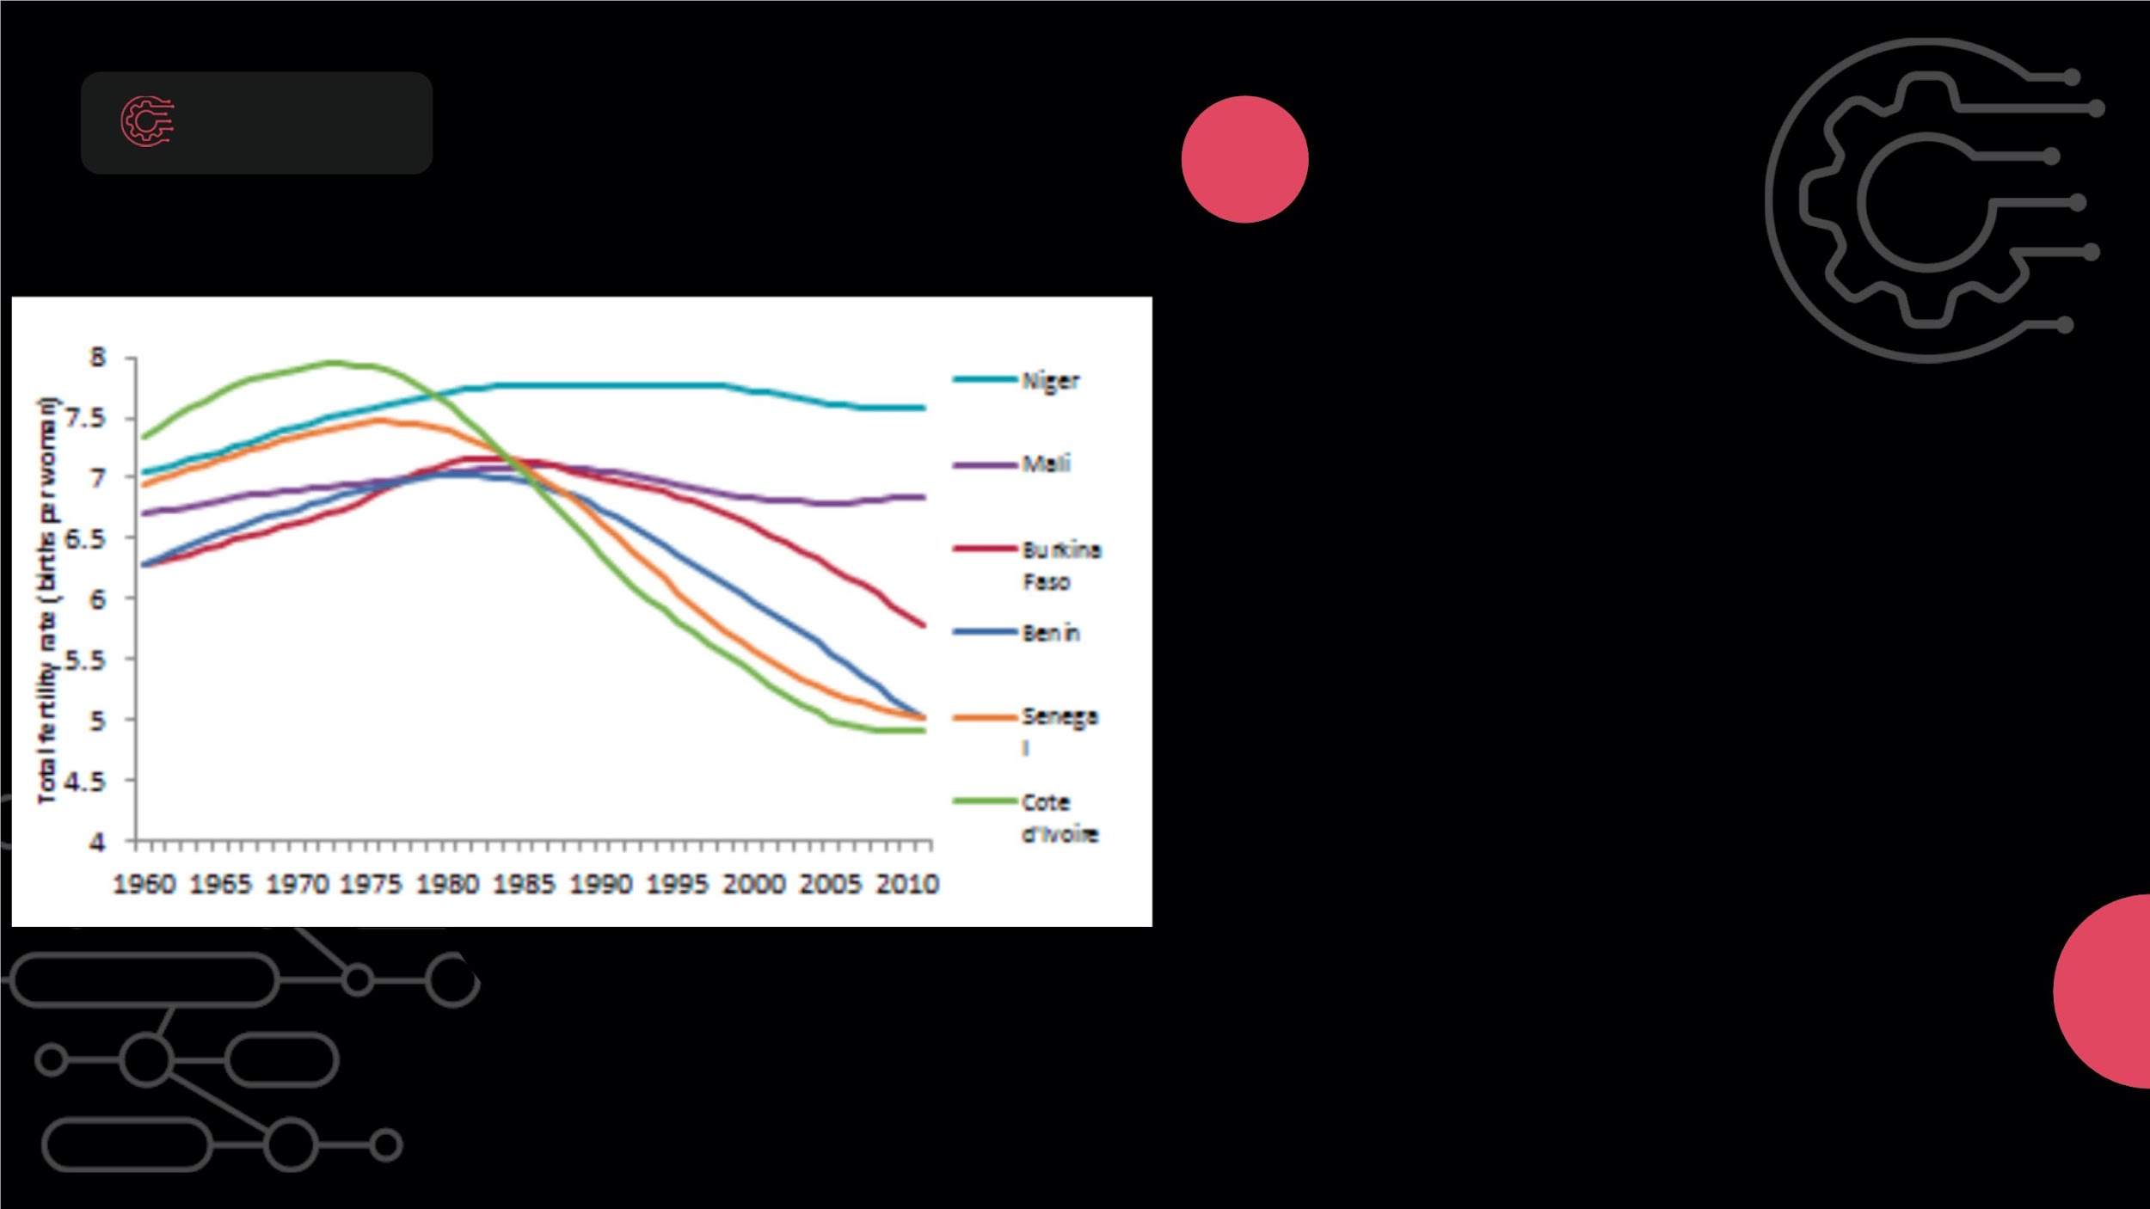
SAHEL REGION
HIGH FERTILITY RATES
LandꢀFragmentation
High fertility rates in Sahelian
communities lead to subdivided, smal
land plots, often shared among multip
heirs.
Impactꢀonꢀ
Sustainability
Land fragmentation complicates
sustainable practices like crop rotatio
and conservation, making the land mo
prone to soil erosion and desertificatio

Slide 33
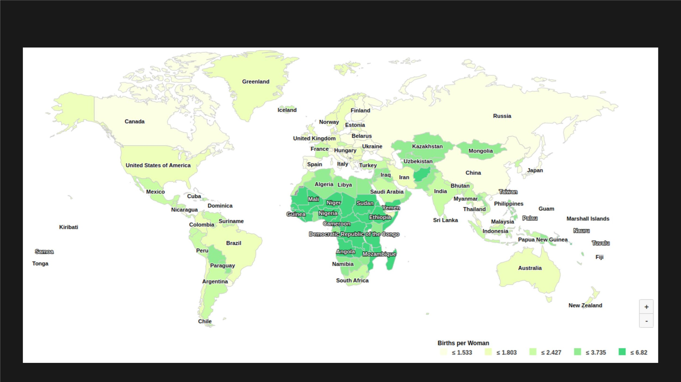
FERTILITY RATES ACROSS THE WORLD

Slide 34
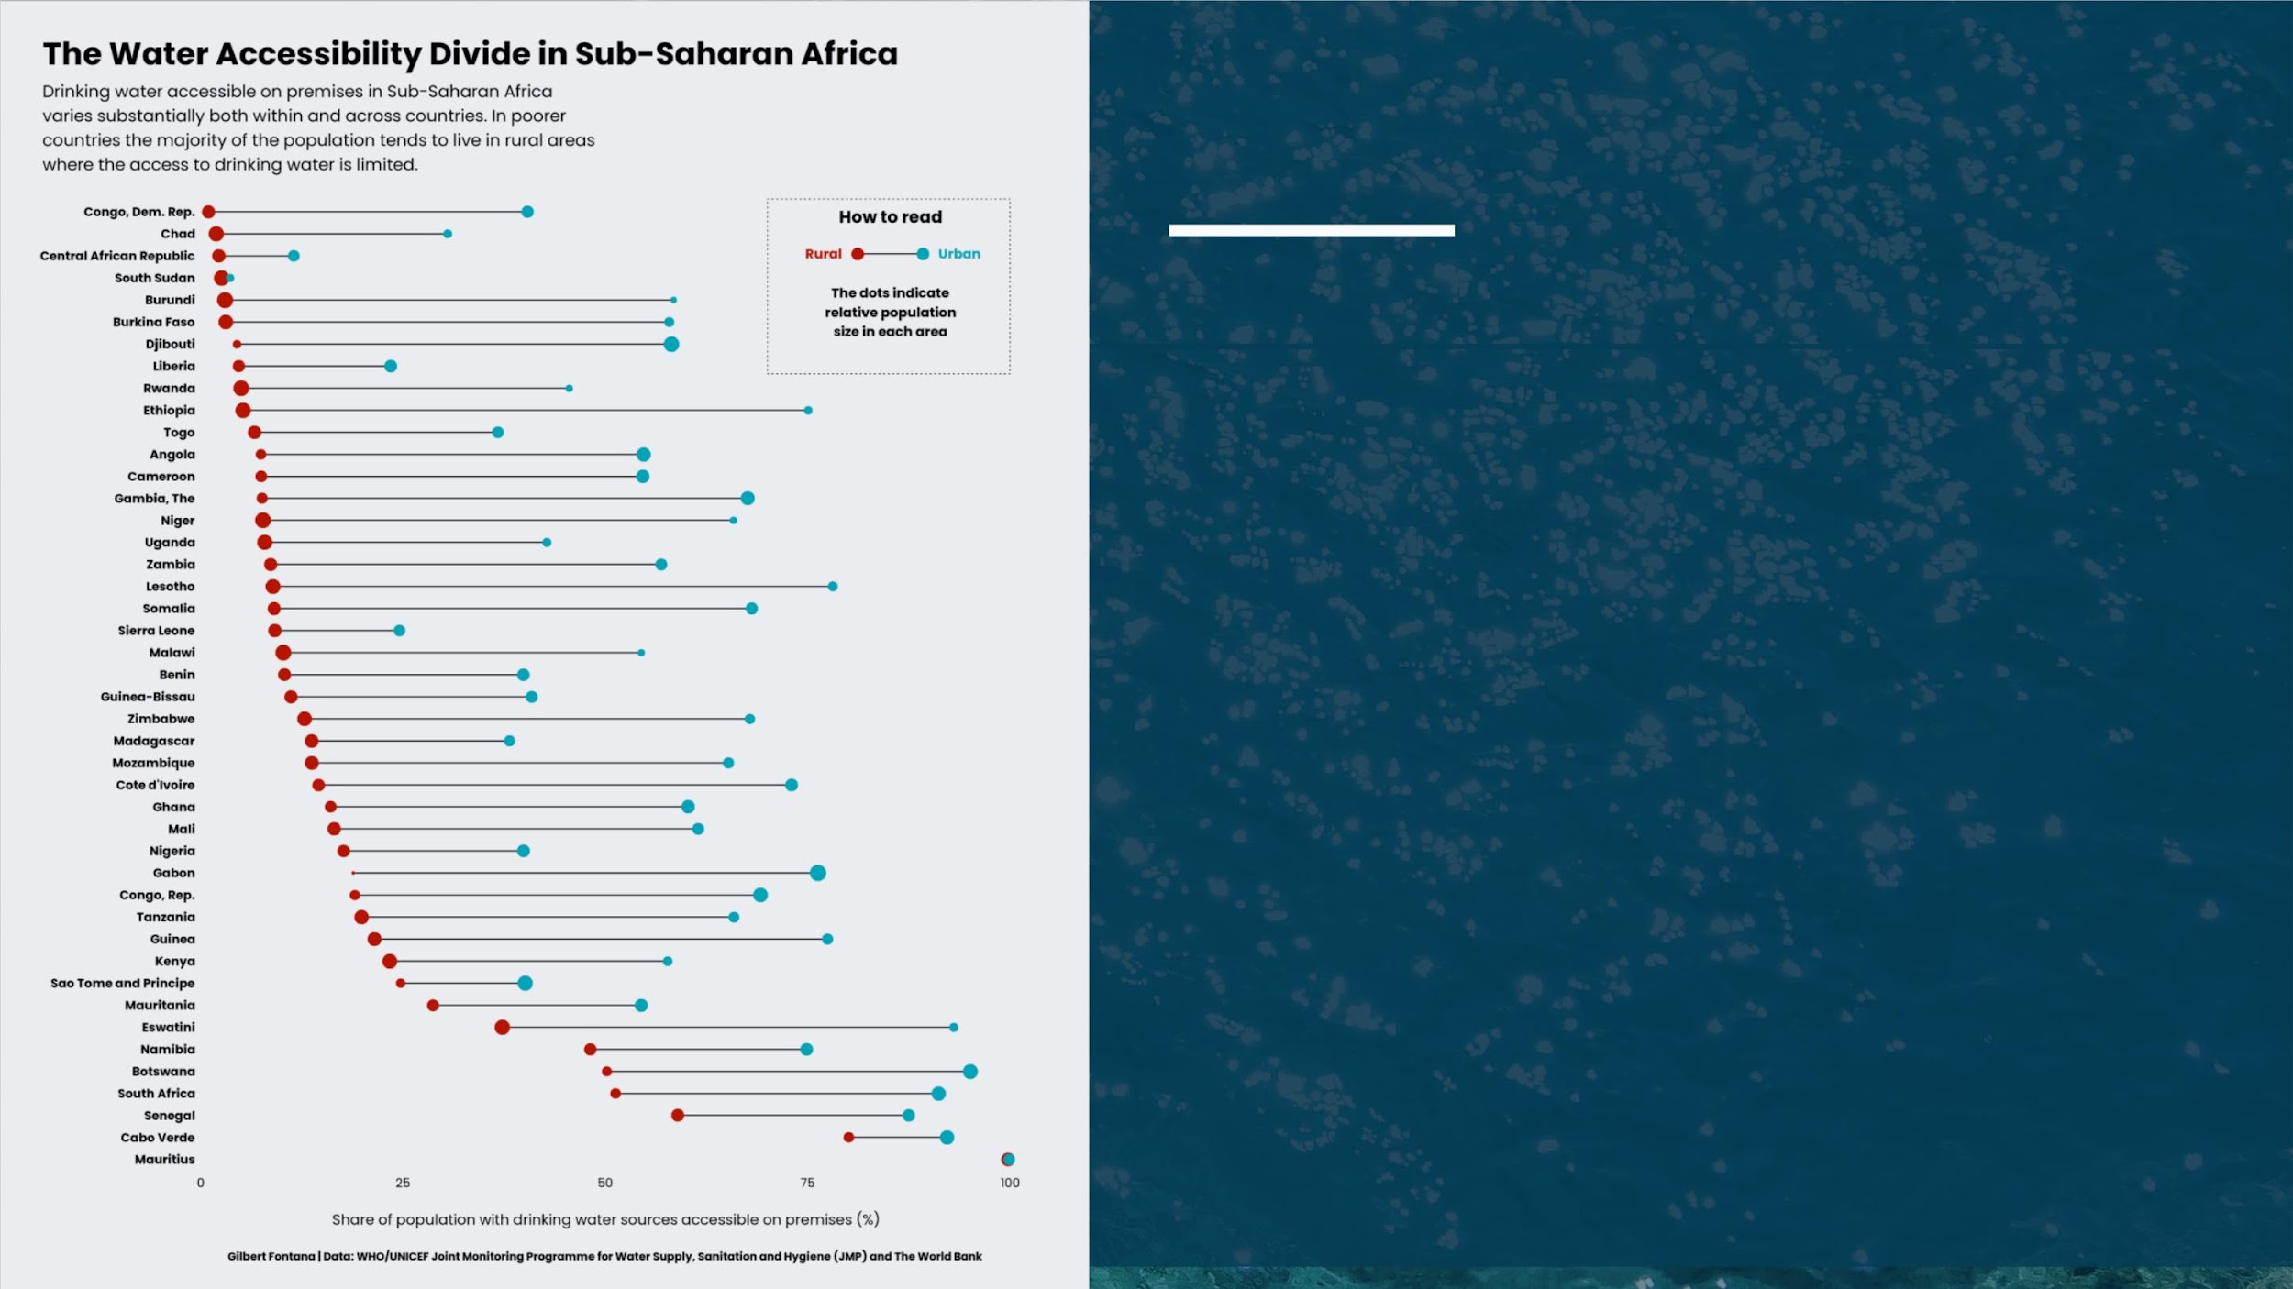
DESERTIFICATION IN SAHEL REGION
WATER STRESS
Rising population density exacerbates
water scarcity, as more people draw from
already limited water sources. This
contributes to the overuse and depletion
of aquifers and surface water bodies,
negatively impacting the region's
ecosystem and accelerating
Effects of
Deforestation
on Wildlife
desertification.

Slide 35
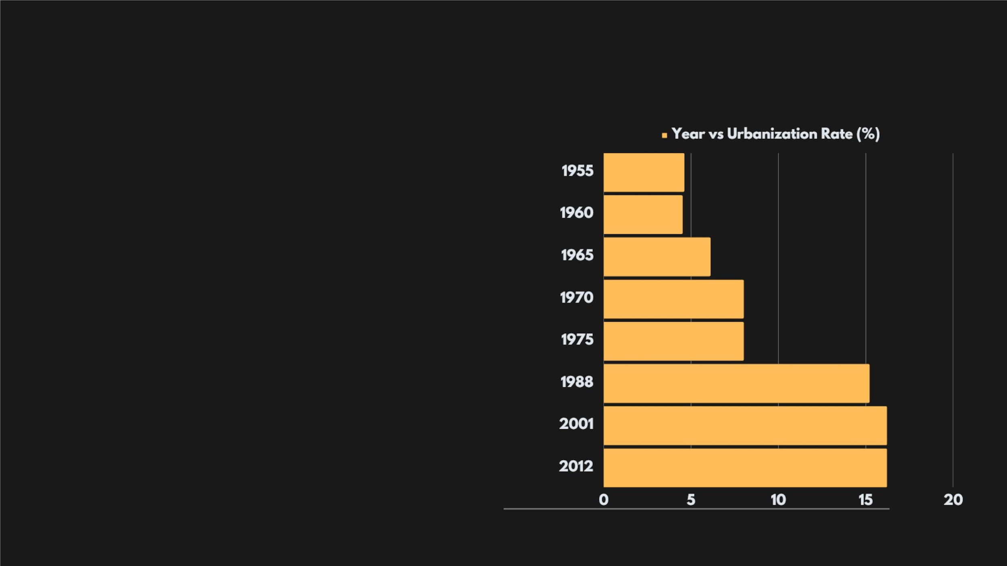
URBANIZATION
As rural populations in the Sahel grow, many
individuals seek better economic opportunities
in urban areas. This trend has led to significant
urbanization. The demand for housing and
infrastructure in peri-urban areas often
resulted in the clearance of vegetation and
topsoil, which made these areas more
susceptible to desertification.
The graph reveals a consistent upward trend in
urbanization rates across years in the Sahel
region. This urban expansion impacts land use
and can exacerbate desertification.

Slide 36
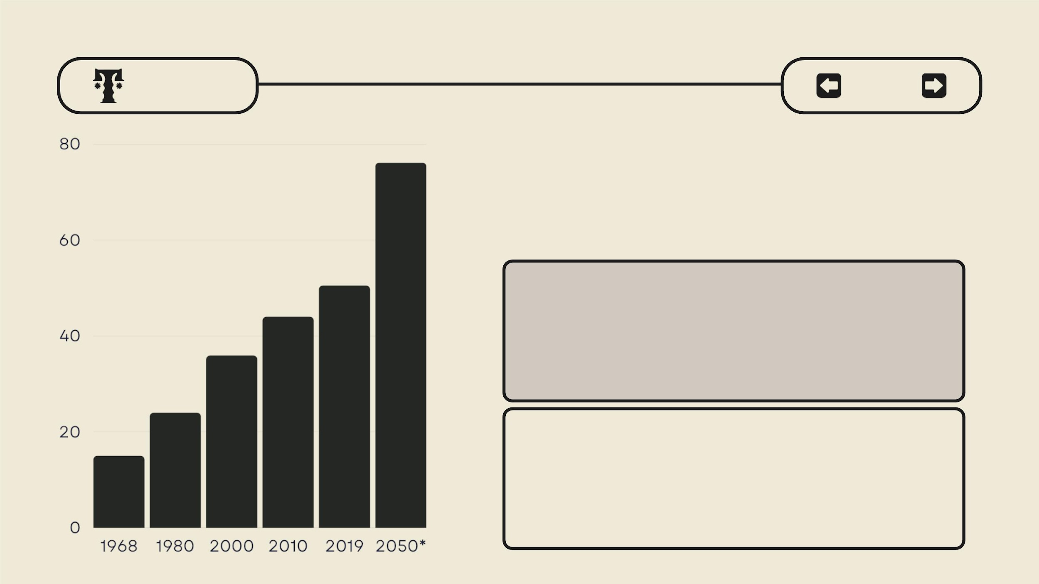
CASE
STUDY
| DESERTIFICATION |
SAHEL
RURAL
POPULATION
LAND CLEARANCE
Sahelianꢀruralꢀcommunitiesꢀheavilyꢀdependꢀonꢀ
subsistenceꢀfarming,ꢀnecessitatingꢀexpandedꢀ
cultivationꢀthatꢀoftenꢀleadsꢀtoꢀdeforestationꢀandꢀsoilꢀ
degradation.
TRANSHUMANCE
Nomadicꢀpastoralism/Transhumanceꢀisꢀcommonꢀinꢀ
theꢀSahel,ꢀbutꢀpopulationꢀgrowthꢀhasꢀledꢀtoꢀ
overgrazing,ꢀdepletingꢀvegetationꢀandꢀintensifyingꢀ
desertification.

Slide 37

YOUTHꢀ
POPULATIONꢀANDꢀ
EMPLOYMENT
DEMOGRAPHICꢀSTRESS
UNEMPLOYMENTꢀIMPACT
DEMOGRAPHICꢀSHIFT
Growing youth populatioHnigh youth unemploymentR,ural-urban youth migrati
strains land resources, stemming from rapid intensifies land pressure,
intensifying desertificatiopnopulation growth, drivesaccelerating land
challenges in the Sahel unsustainable land-use degradation and
region.
practices, worsening
desertification in the Sahe
desertification in the Sahel.

Slide 38

NIGER AGRICULTURE

Slide 39
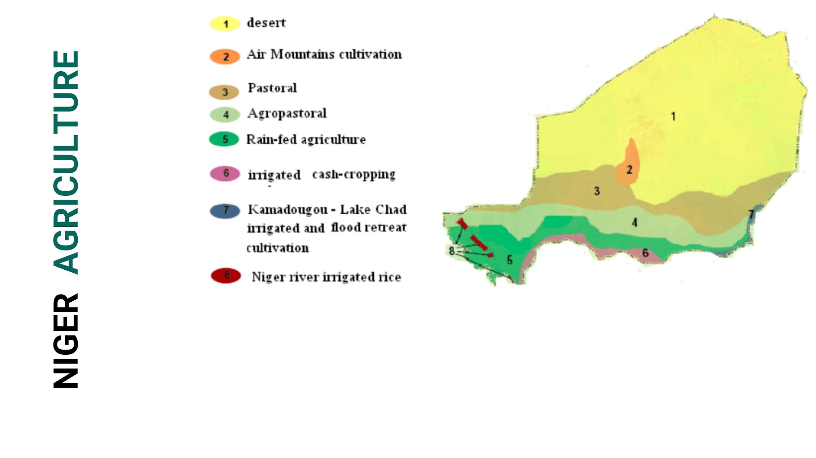
Most parts of Niger are deserted, but the southern
parts flourish with vegetation, particularly in the
region of the Niger River Delta, which is their main
source of water.

Slide 40
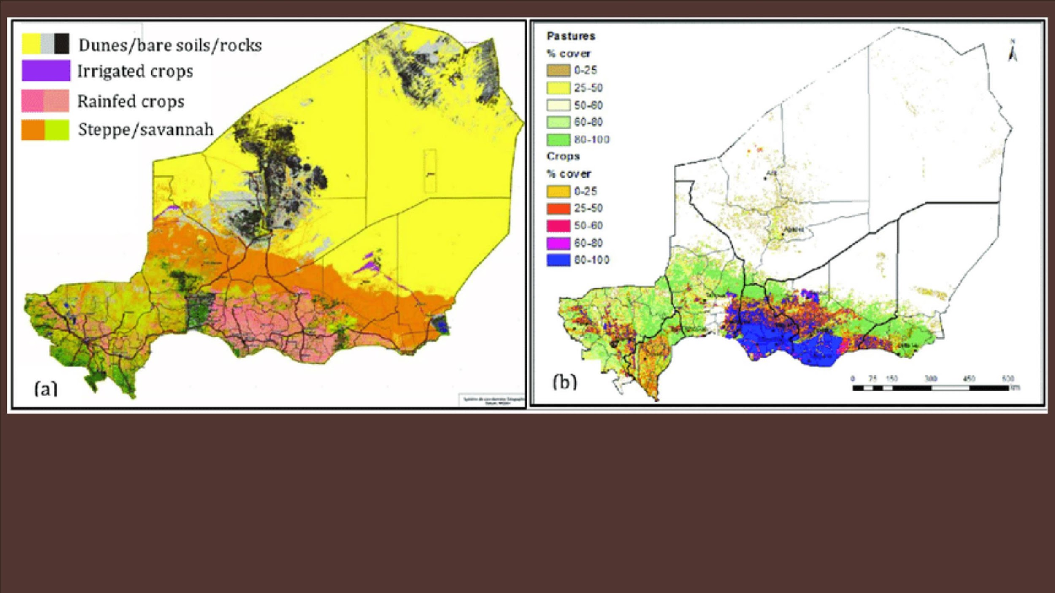
Here, we can discern the geographical divisions:
Areas devoid of crops, Regions cultivating rainfed crops,
and Zones where crops are irrigated

Slide 41
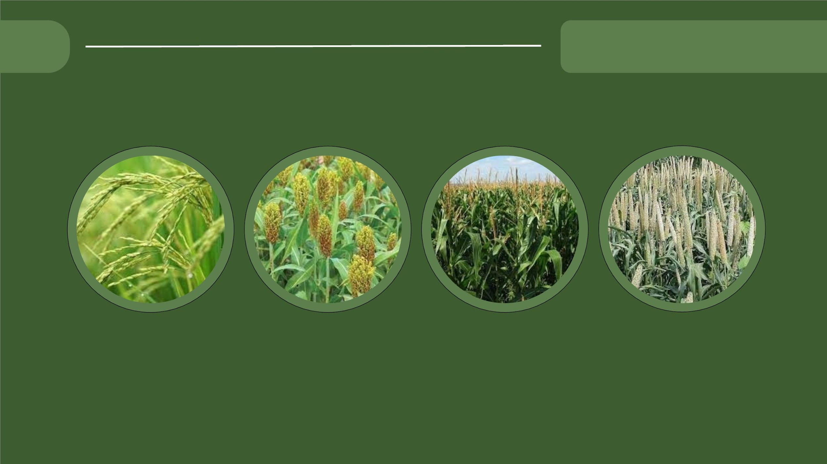
NIGER AGRICULTU
MAIN CROPS GROWN
RICE
SORGHUM
MAIZE
MILLET

Slide 42
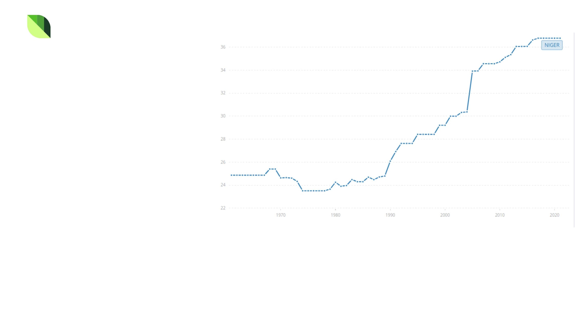
NIGER
AGRICULTUTRE
Why Did Agriculture,
Once Vital, Experience
a Shift?
We can observe that the region boasts a
robust river delta, ideally suited for
cultivating water-intensive crops such as
rice, indicating the pivotal role of
agriculture in the local economy.
Nevertheless, an intriguing question
arises:
What transpired during the 1970s,
resulting in a reduction of
agricultural land?
What key factors precipitated this
decline?

Slide 43
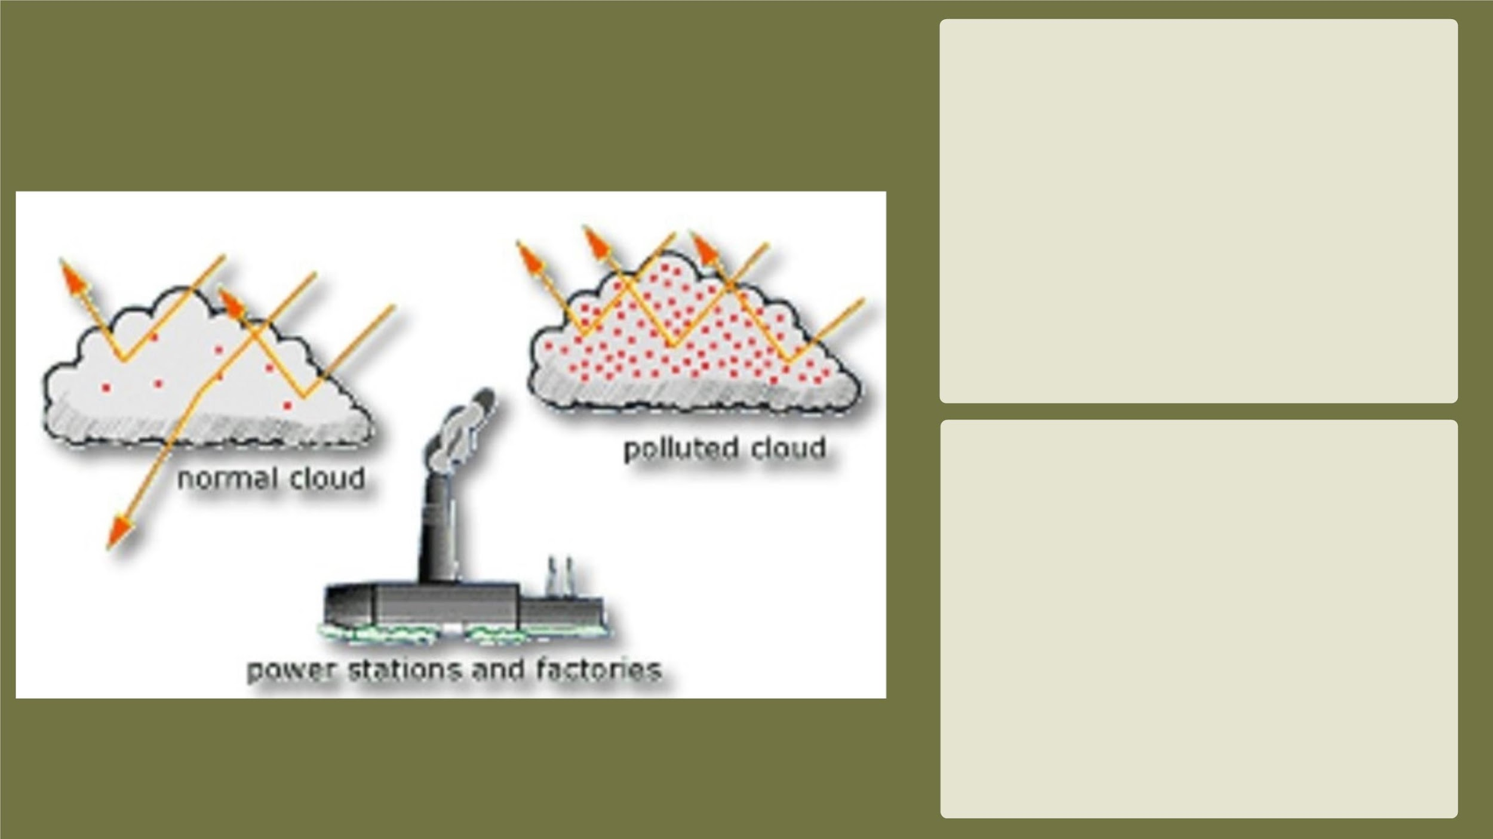
Global Dimming
Global dimming is a process by
which less direct sunlight
reaches Earth's surface due to
aerosol particles, dust, and
pollution in the atmosphere that
reflect sunlight back into space.
Global dimming was observed
throughout the second half of the
twentieth century.
After conducting some studies, it
became evident that the primary
reason for the decrease in
agriculture and food availability
was the decline in food crops,
attributed to a lack of rainfall.This
deficiency in rainfall was caused
by reduced evaporation, a
phenomenon linked to global
dimming.

Slide 44
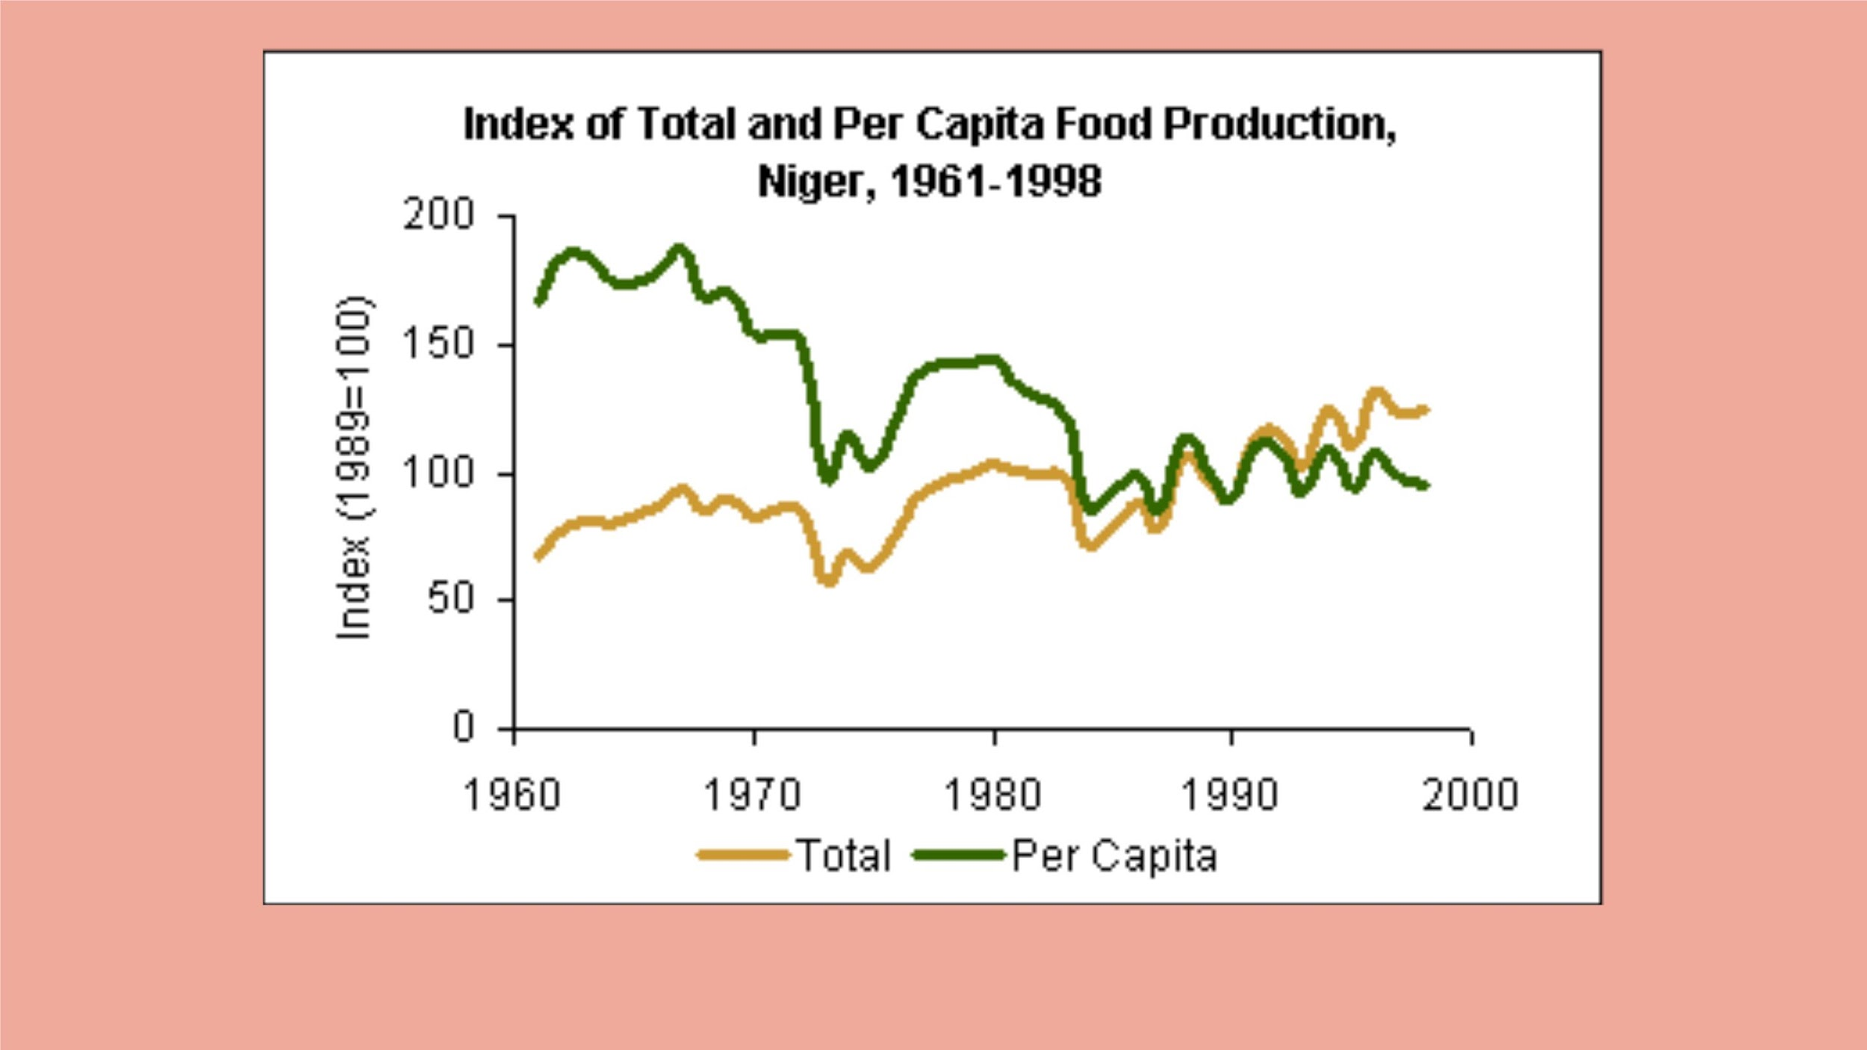
In the graph presented above, we can discern both per capita and total effects

Slide 45

SUMMA
RY
• Global dimming reduced rainfall in Niger by an average of 20% between 1960 and 1990.
This decline significantly impacted crops highly dependent on rainfall.
• This reduction of agricultural production caused Niger's GDP growth rate to slow down to
0.5% per year during the 1970s and 1980s, which caused an increase in poverty from 40%
in 1970 to 60% in 1990.
• Factors such as population growth, land degradation, and climate change also contributed
to the economic and agricultural challenges faced by Niger during this period.

Slide 46
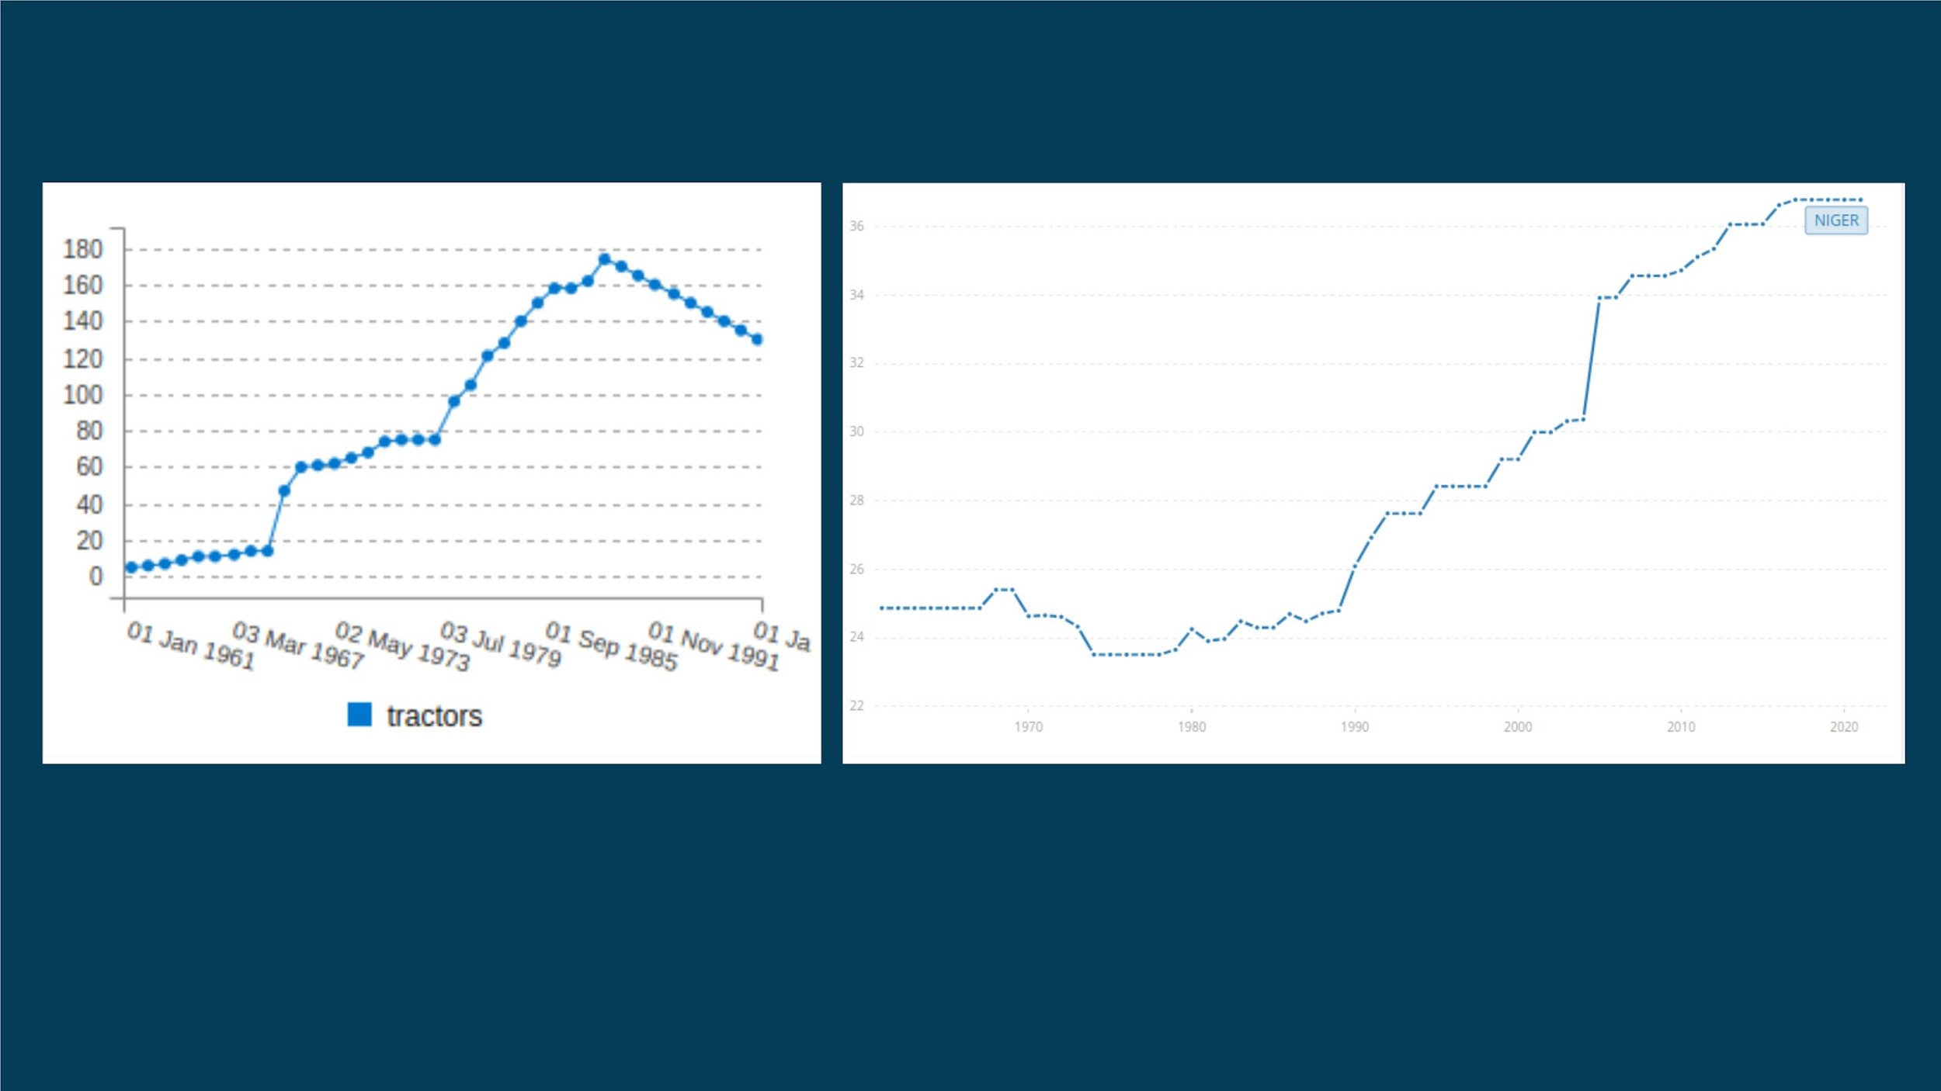
Ågrïçültürål Rëbøüñd
AgriculturalꢀMachineryꢀ,ꢀTractors
%ꢀofꢀAgriculturalꢀLand
Recovery is evident in the statistics, but what might be the primary contributing fac

Slide 47
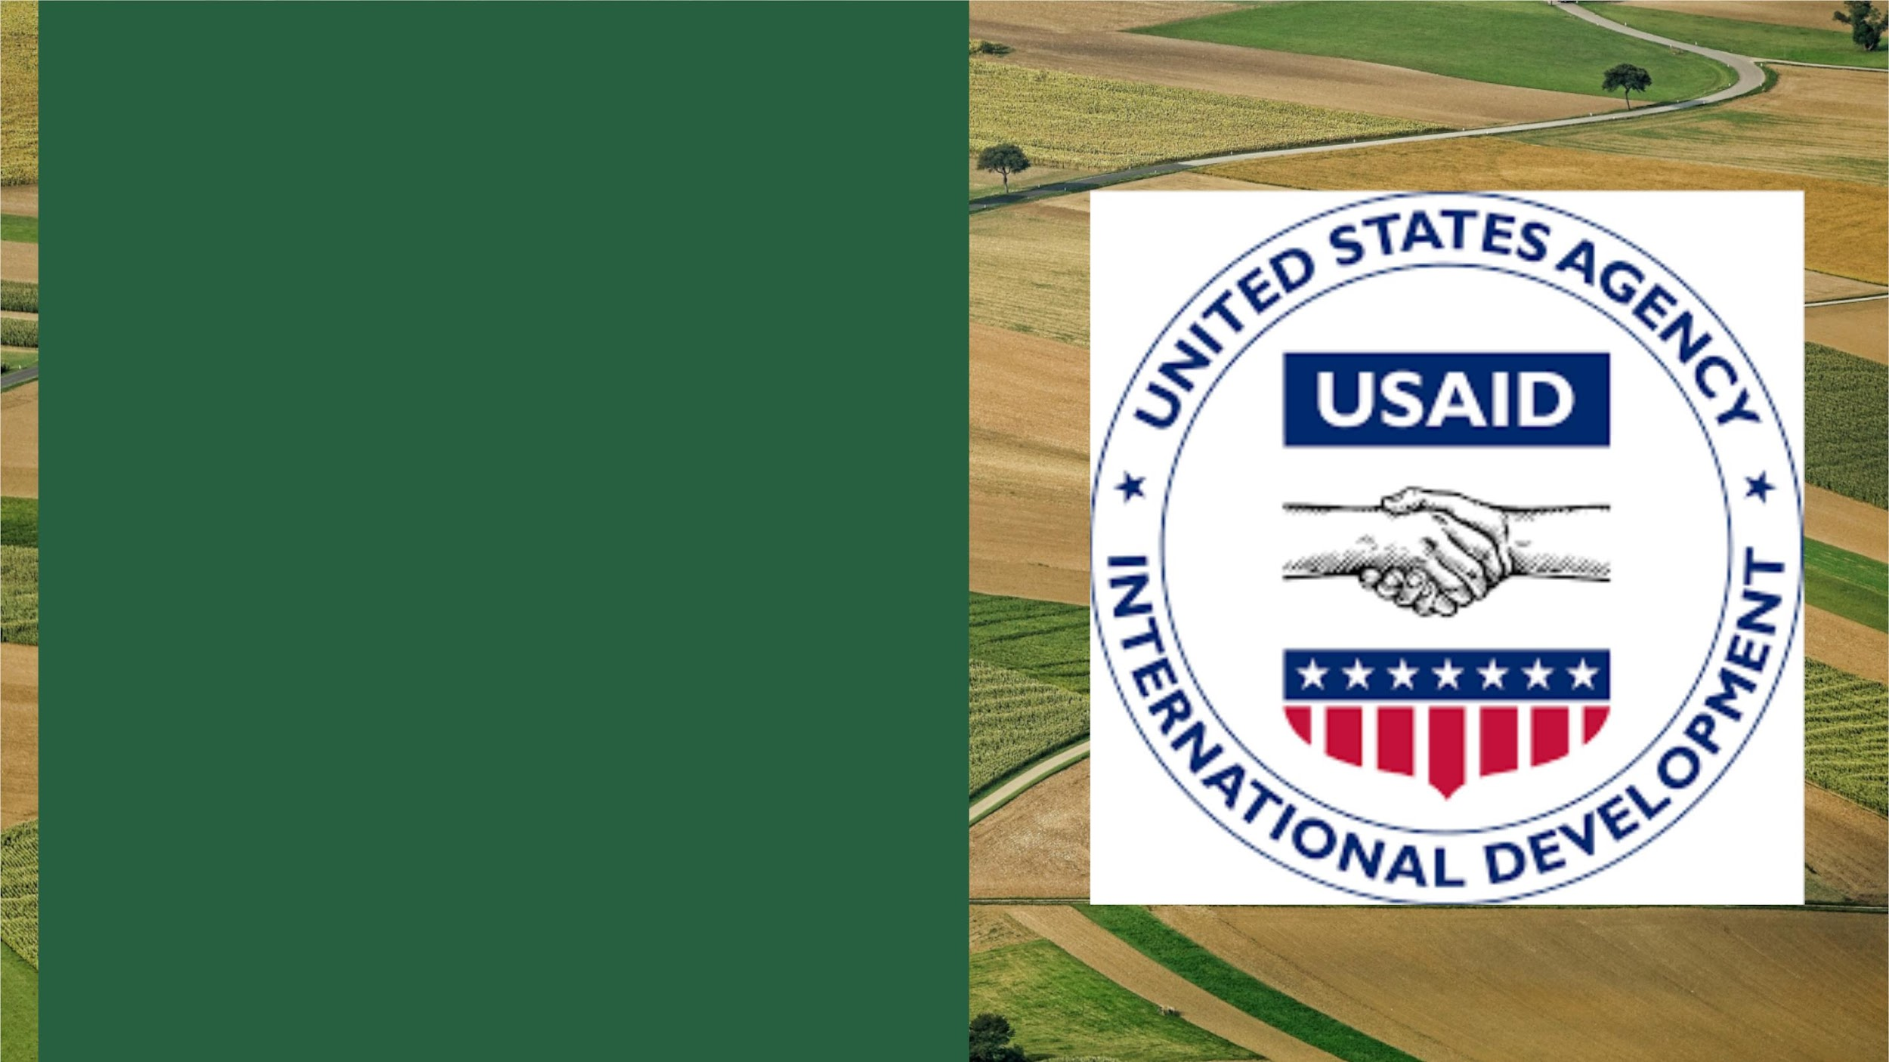
USAID
Efforts by USAID and Development Organizations:
• Investments by USAID and development
organizations aimed at enhancing resilience
through land rehabilitation activities.
• Focus on restoring degraded lands and
improving water conservation to support
agriculture and food security.

Slide 48

WFP
TheꢀWorldꢀFoodꢀProgrammeꢀ(WFP)ꢀhasꢀplayedꢀaꢀsignificantꢀroleꢀinꢀhelpingꢀ
theꢀregionꢀofꢀNigerꢀbyꢀimplementingꢀvariousꢀprogramsꢀandꢀinitiativesꢀ
aimedꢀatꢀaddressingꢀfoodꢀsecurityꢀandꢀhumanitarianꢀchallenges
• ProvidingꢀFoodꢀAssistance
• NutritionꢀPrograms
• SchoolꢀFeedingꢀProgramsꢀꢀꢀꢀꢀꢀꢀꢀꢀ
• EmergencyꢀResponseꢀꢀꢀꢀꢀꢀꢀꢀꢀꢀꢀꢀꢀꢀꢀꢀꢀꢀ
• CashꢀandꢀVoucherꢀAssistance
• AgriculturalꢀandꢀResilienceꢀPrograms
• MonitoringꢀandꢀAssessment
• CapacityꢀBuilding
• AdvocacyꢀandꢀAwareness

Slide 49
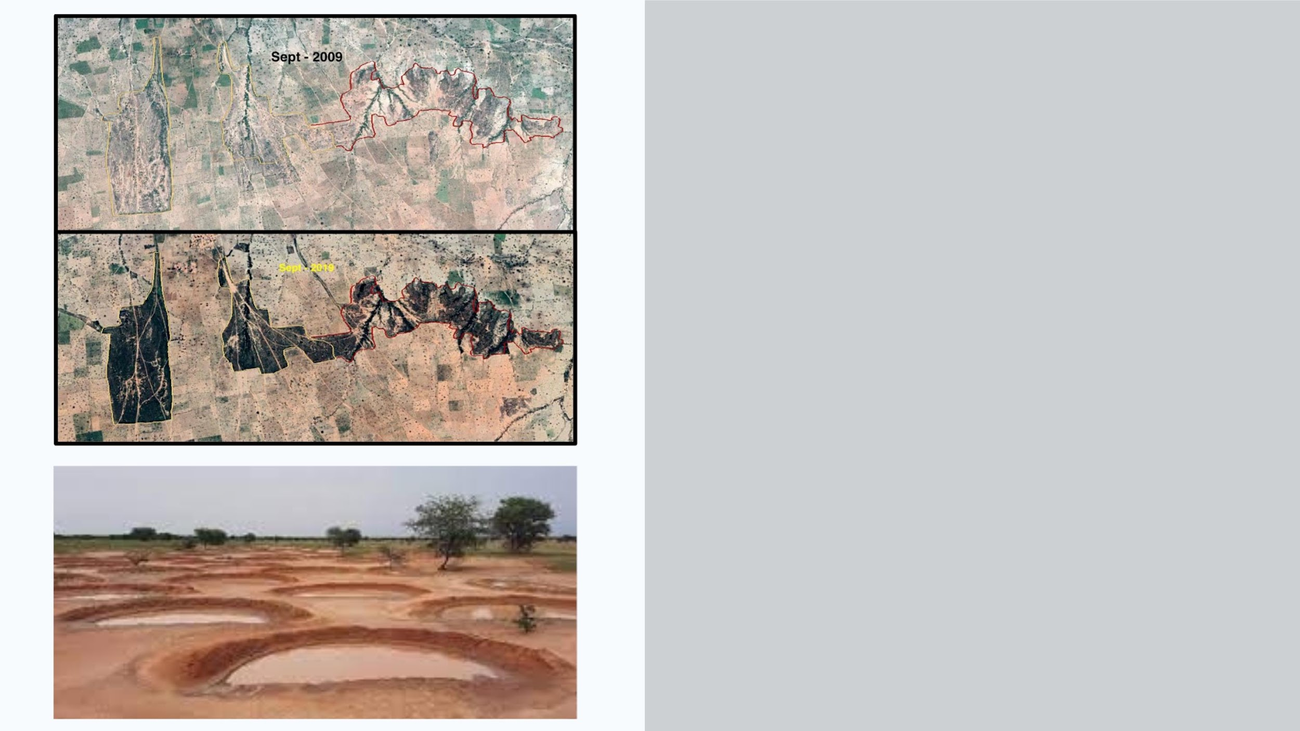
Half-Moon Technology
The use of half moons as a technology for
water harvesting in Niger is a significant
initiative that has been supported by USAID
and other development organizations. The
practice involves creating half-moon-shaped
ditches in the ground to capture and retain
rainwater, effectively improving water
management and enhancing agricultural
productivity.

Slide 50
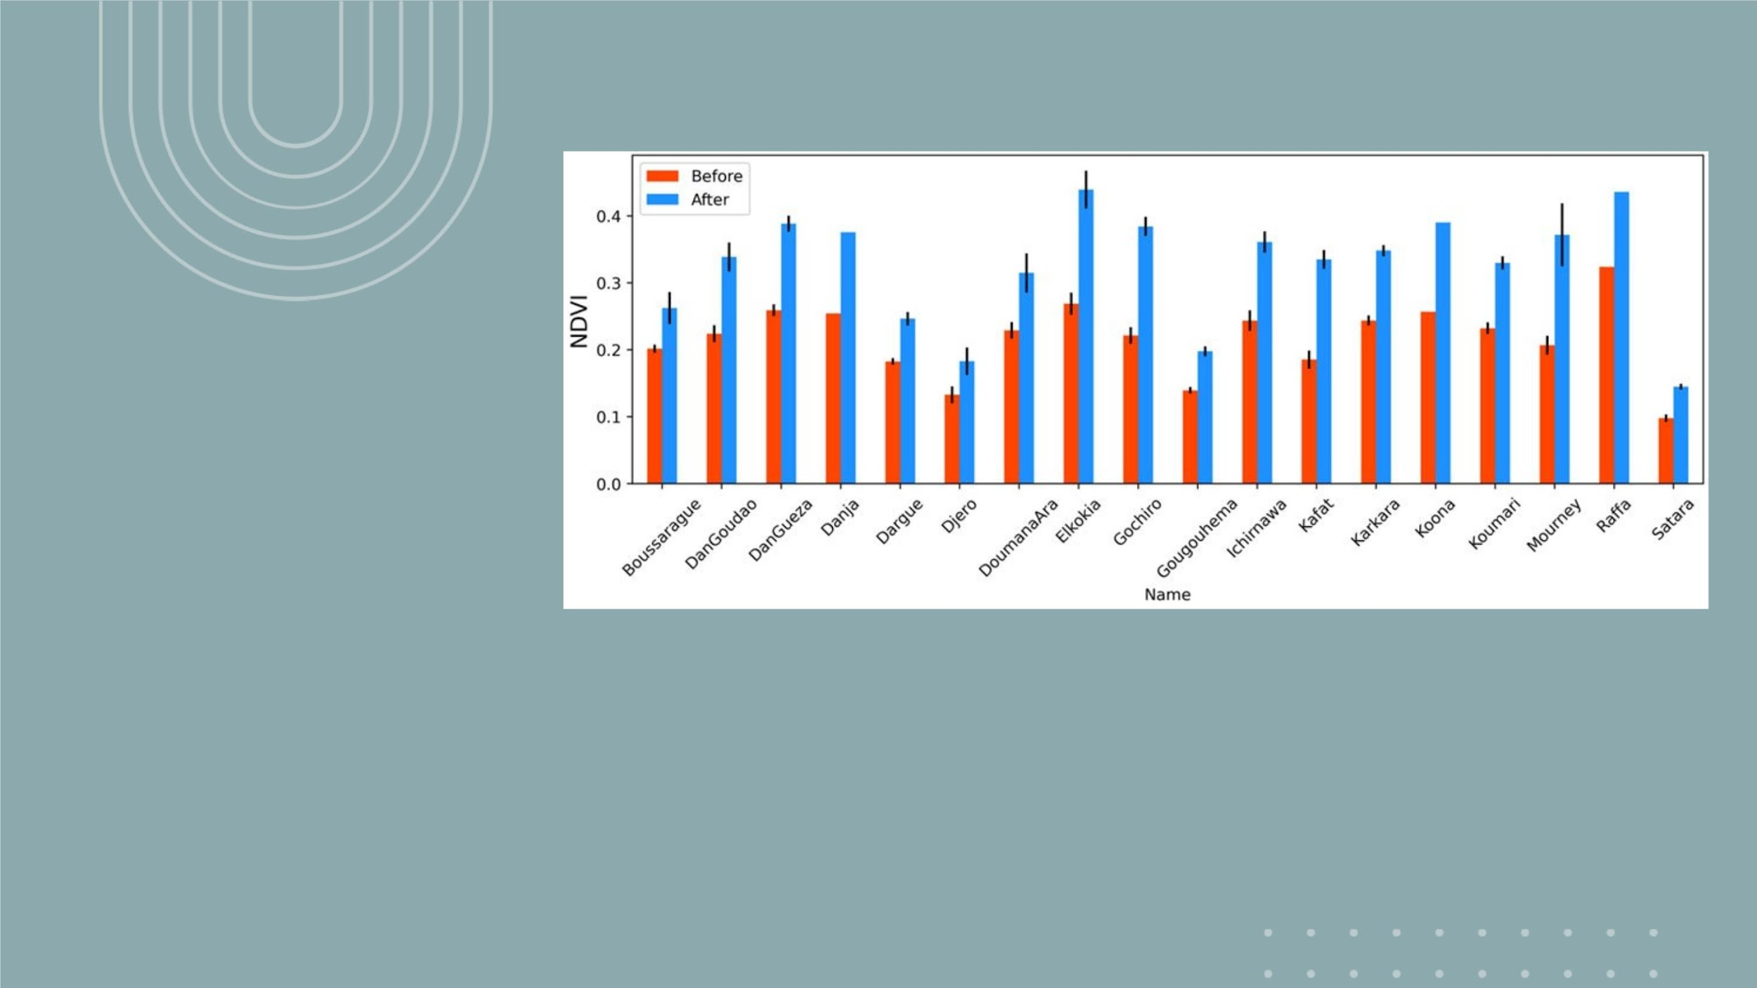
WHAT IS IT ?
• Half moons are a water harvesting technique in which small, crescent-shaped ditches are dug into
the earth, forming a series of low barriers that slow the flow of rainwater and encourage its
infiltration into the ground.
• This method effectively stores rainwater in the root zone of crops and helps recharge
groundwater aquifers. Half moons are typically constructed in parallel rows across fields to
maximize water capture. The barriers reduce soil erosion and help conserve precious water
resources in a region where water scarcity is a persistent challenge.

Slide 51
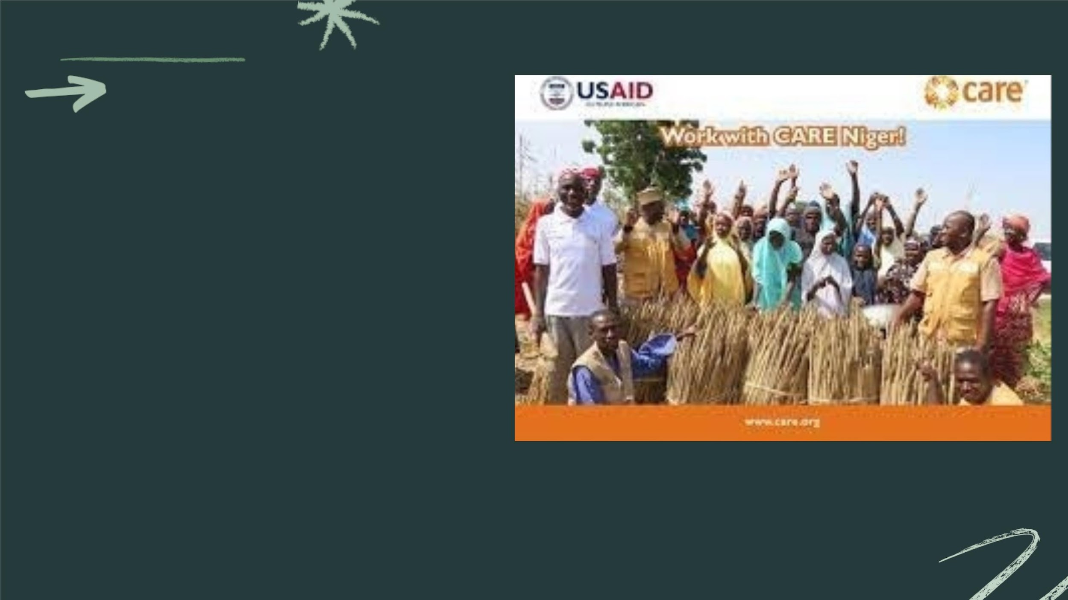
USAID
The adoption of half moons has had a profound impact
on the people of Niger. By enhancing water availability
for agriculture, it has increased crop production,
reduced food shortages, and improved the overall
standard of living for rural communities. Furthermore,
the technology has empowered farmers to mitigate the
effects of drought and adapt to the challenges posed
by a changing climate. In addition to improved food
security, half moons have also contributed to better
income prospects and reduced vulnerability to drought-
related crises, ultimately supporting the resilience of
Niger's population.
In summary, the promotion of half moons for water
harvesting in Niger, supported by USAID and other
organizations, has proven to be a sustainable and
effective solution to combat water scarcity and
enhance agricultural productivity, thereby positively
impacting the lives of the people in this region.

Slide 52
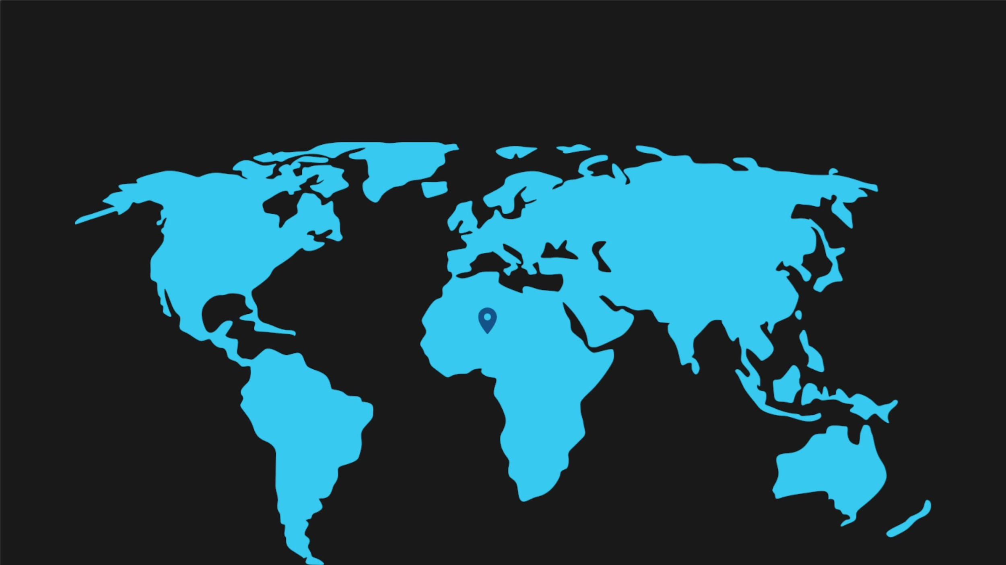
COMPOSITE DROUGHT INDEX - CDI

Slide 53
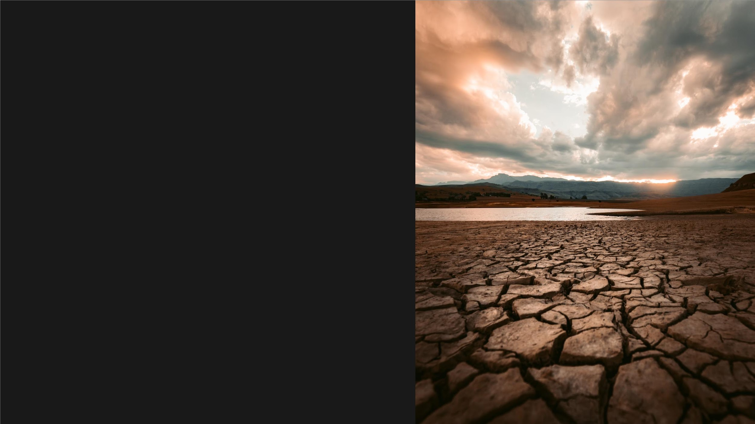
Drought
• Difficult to accurately identify onset and end as they
start and end gradually
• 1.1 Billion people affected by droughts between
1994 and 2013 with Africa being the most affected
continent
• Droughts in the Sahelian region in the 1970s and
80s severely impacted livestock and crop
productivity
• They also caused land degradation, and hence,
ultimately, desertification
• Effective strategies needed to predict droughts
along with the susceptibility of regions

Slide 54
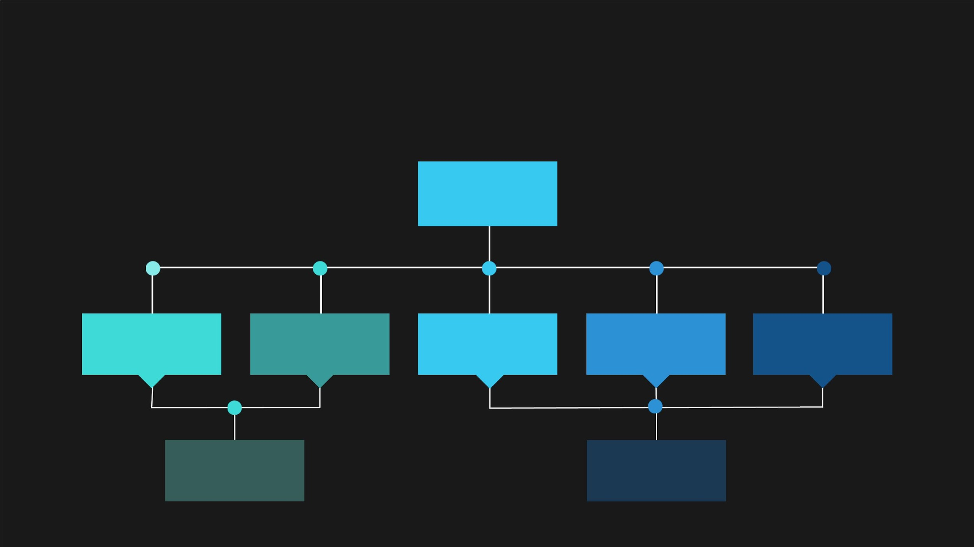
ISSUES WITH
TRADITIONAL ESTIMATORS
Drought Indices
Historical
Ground station
data
Precipitation
Anomalies
Quantiles
Standardized
Hydroclimatic Data
Precipitation Index
Scarcity of
Data
Correlation between
factors absent

Slide 55
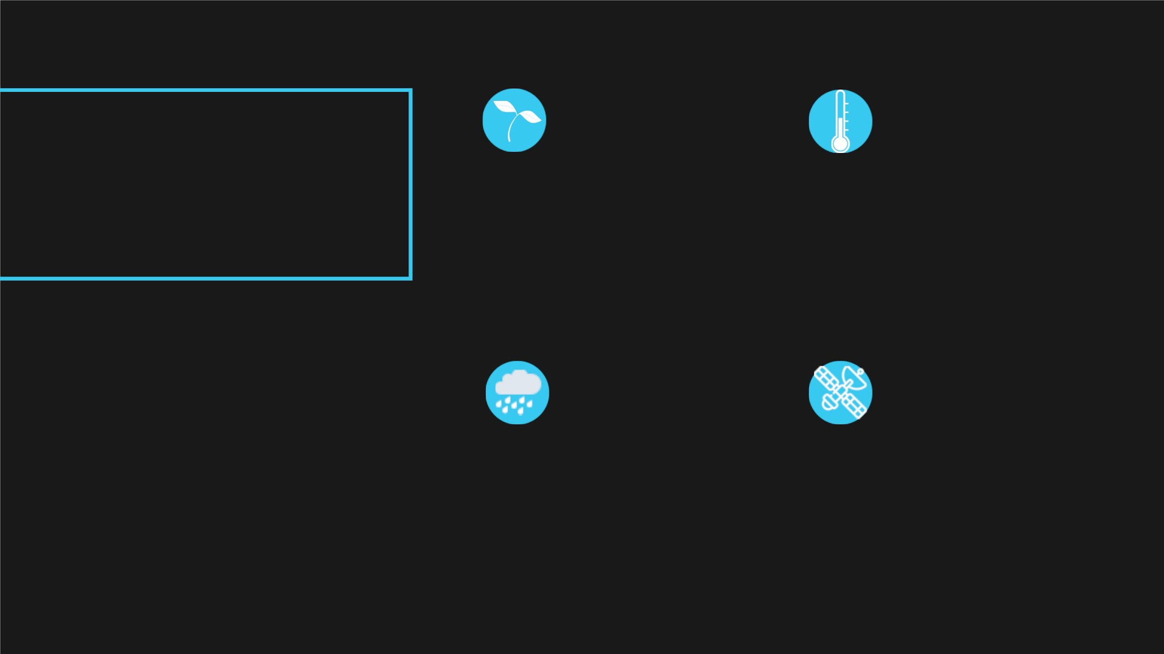
COMPOSITE
DROUGHT INDEX
(CDI)
VEGETATION
TEMPERATURE
NDVI(NormalizedDifference LST(LandSurface
VegetationIndex) is used to Temperature) is used to
obatain vegetation info.
Collected from MODIS
analyse land temperatu
Collected from MODIS
• CDI-3 - CDI values computed over 3
months instead of 1 month
• MODIS - MODerate resolution
PRECIPITATION
REMOTE SENSING DATA
Imaging Spectroradiometer
Precipitationdata is used to All data is collected thro
measure the average rainfall remote sensing unlike
• CHIRPS - Climate Hazards group
across areas.
traditional methods tha
on ground stations
InfraRed Precipitation with Stations
Collected from CHIRPS

Slide 56
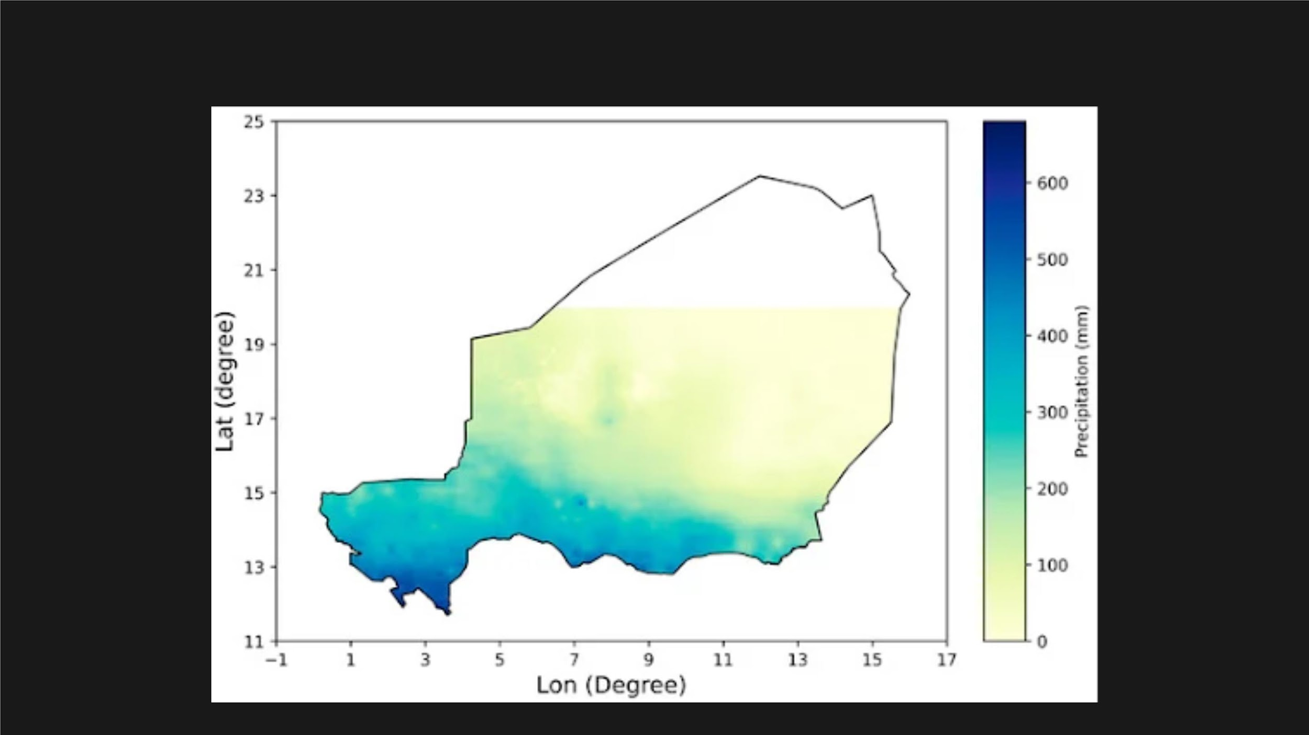
Mean seasonal rainfall (2000-2020)

Slide 57
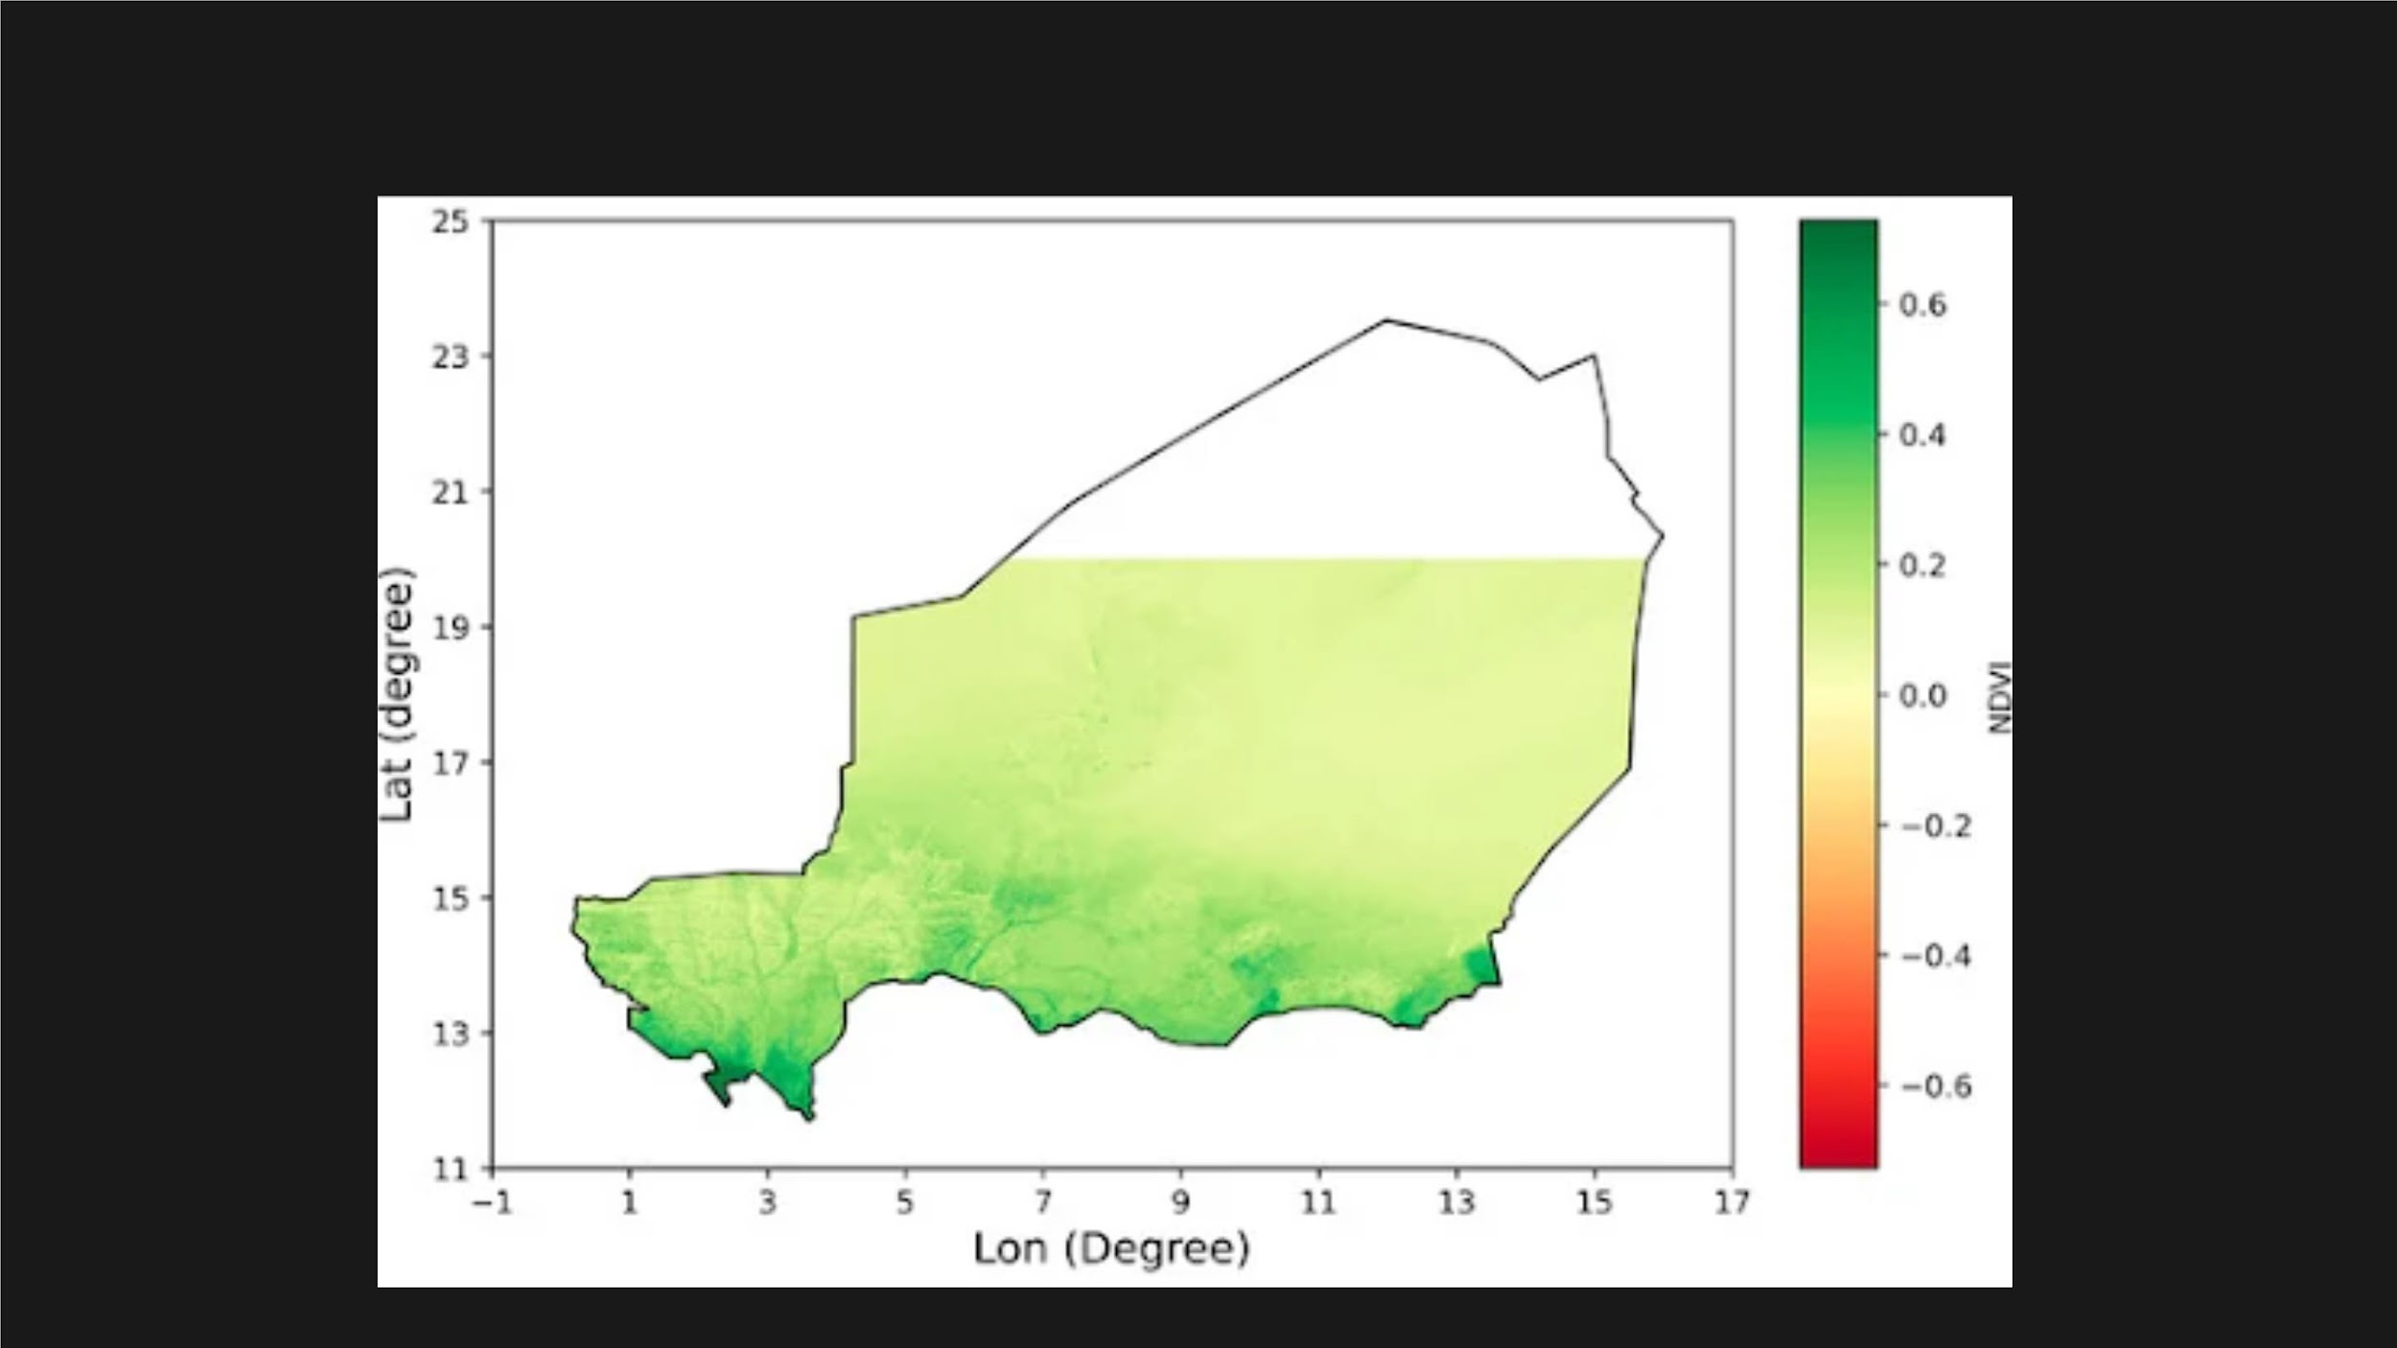
Mean seasonal NDVI (2000-2020)

Slide 58
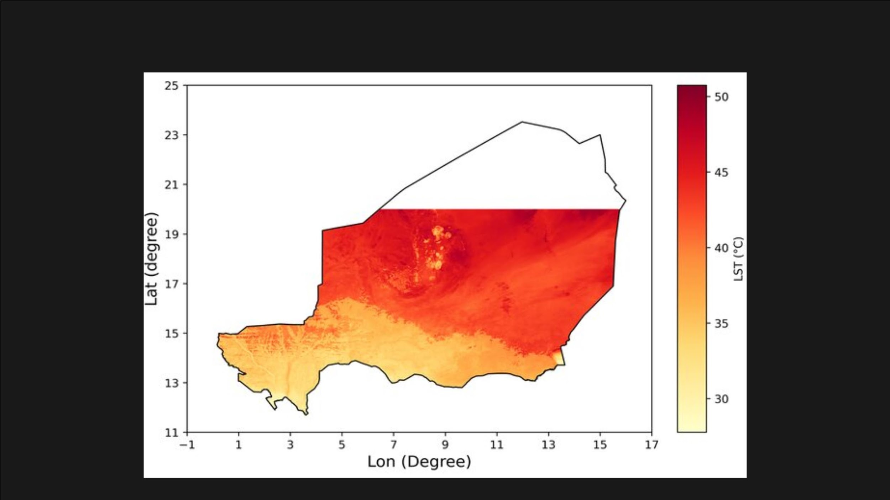
Mean seasonal daytime LST (2000-2020)

Slide 59
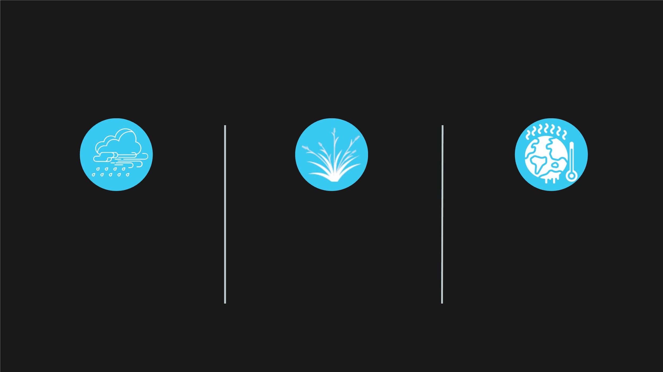
VARIABLE PREPOROCESSING AND VALIDITY
ESTIMATION FOR CDI CALCULATION
PRECIPITATION
NDVI
LST
CHIRPS precipitation data
has to be bias-corrected
using ground observation
data and resample to it to
1km x 1km resolution
The MODIS NDVI measurements
are impacted by aerosol content
in the atmosphere but found to
have an overall accuracy within
±0.025 units across the Sahel
region
The MODIS LST has b
shown to be valid acr
various land cover types
various studies irrespectiv
the atmospheric condit

Slide 60

CDI CALCULATION
5-Step Process with 3 variables - Precipitation, NDVI, LST
1
2
3
4
5
Entropy
Measure
&
Variable
Categorisation
&
Maximum Driest
Condition, MDC
&
CDI from
Present
Condition (PC
& MWC, MDC
Entropy
Weights
Degree of
Diversification
Maximum Wettest
Condition, MWC
Normalisation

Slide 61
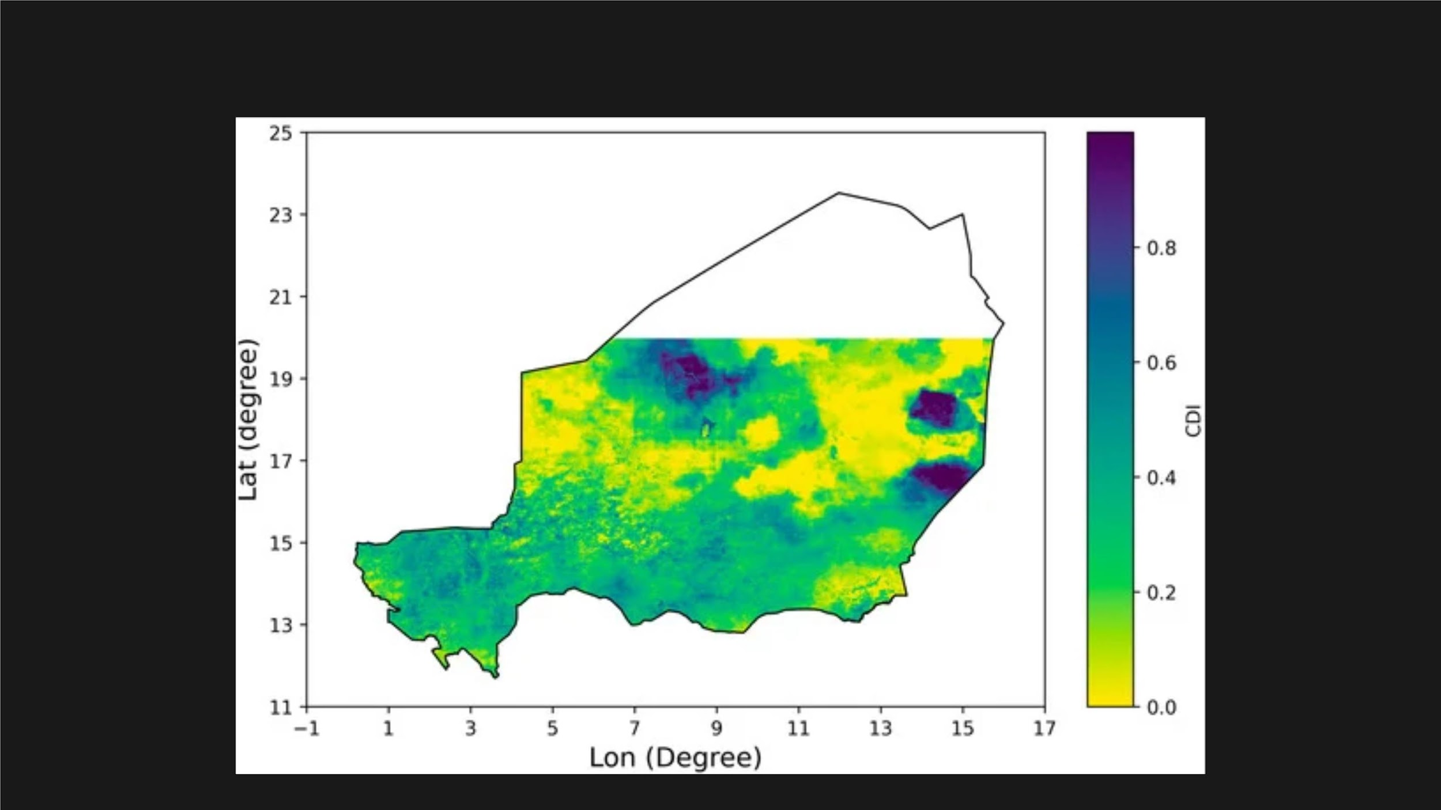
Drought map of 2000 based on CDI-3

Slide 62
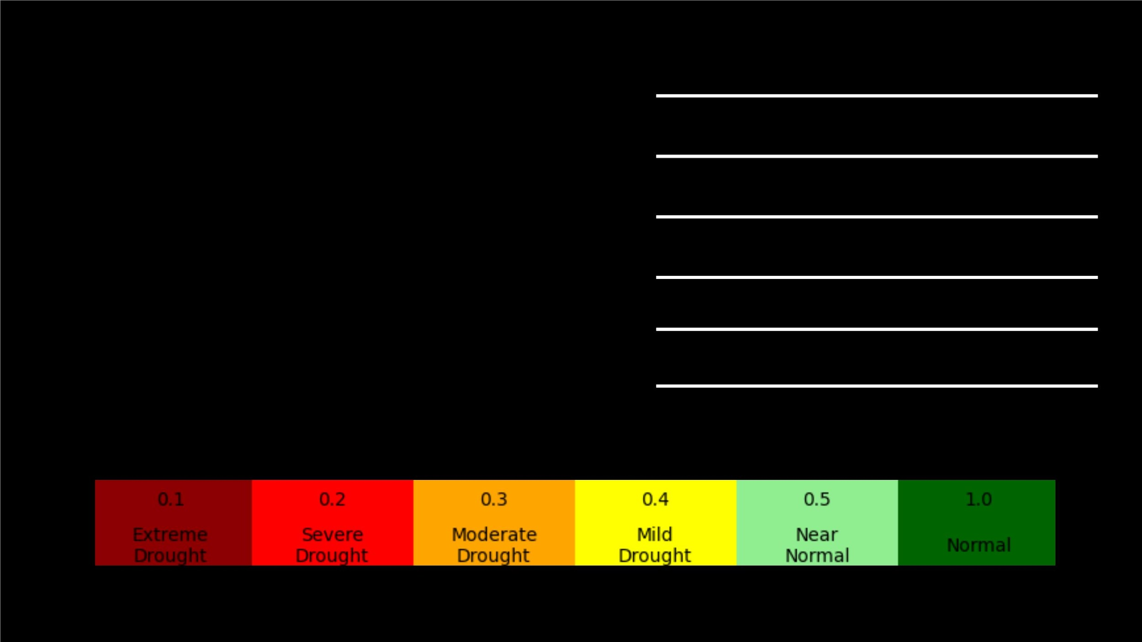
CDI Interval Classification
<0.1
Extreme Drought
DROUGHT CLASSES
BASED ON
0.1-0.2
Severe Drought
Moderate Drought
Mild Drought
0.2-0.3
0.3-0.4
0.4-0.5
CDI VALUES
Near Normal
>0.5
Above Normal

Slide 63

Data
Visualization

Slide 64
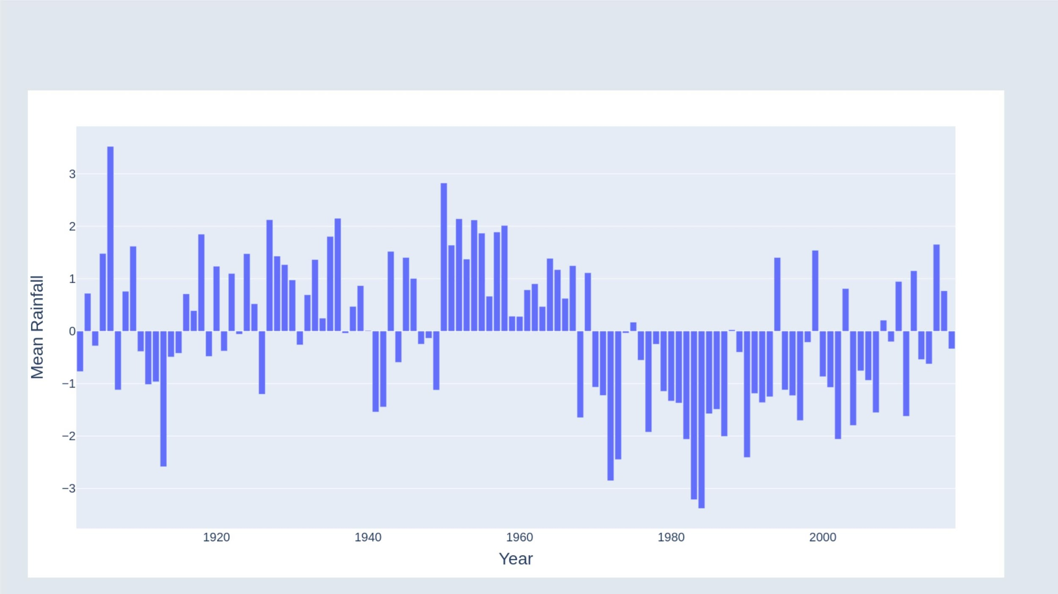
Mean Annual Rainfall

Slide 65
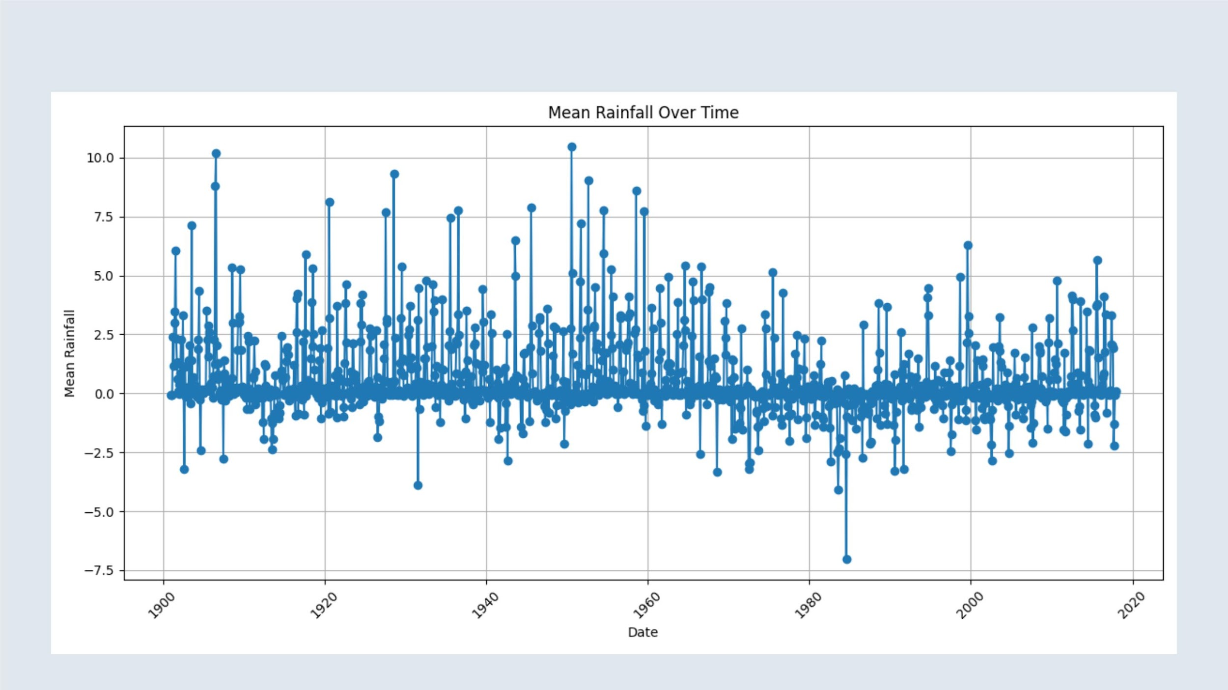
Average Monthly Rainfall

Slide 66

Monthly Rainfall Across Desertification Phases

Slide 67

Effect of El-Nino on Precipitation in Sahel

Slide 68

DISTRIBUTION OF LAND USAGE IN KEITA VALLEY

Slide 69

Land Cover Conversions from 1990 to 2015

Slide 70

Land Cover Changes from 1990 to 2015

Slide 71

LEAF AREA INDEX - WAKANAMA_SUD STATION

Slide 72

LEAF AREA INDEX - WAKANAMA_NORD STATION

Slide 73

Cover Height Mean - WAKANAMA_SUD STATION

Slide 74

Cover Height Mean- WAKANAMA_NORD STATION

Slide 75

Dry Total Biomass Mean - WAKANAMA_SUD STATION

Slide 76

Dry Total Biomass Mean - WAKANAMA_NORD STATION

Slide 77

Fertility Rates in West Africa

Slide 78

Life Expectancy across West Africa

Slide 79

Infant Mortality Rates in West Africa

Slide 80

HDI Rankings of Countries in West Africa

Slide 81

Annual Population Growth Rates in West Africa

Slide 82

Population Age Median

Slide 83

Niger’s share of World Population

Slide 84

Niger's World Population Ranking

Slide 85

Niger's Urban Population %

Slide 86

Yearly Change in Niger’s Population

Slide 87

Total Population of Niger

Slide 88

Cropwise Yield in Sahel Region

Slide 89

Cropwise Harvested Area in Sahel Region

Slide 90

Cropwise Production in Sahel Region

Slide 91

Sorghum Harvest Area in africa

Slide 92

Millet Harvest Area in africa

Slide 93

Total Rice Production by Country

Slide 94

Harvested Area of Rice by Country

Slide 95

Website

Slide 96

Frameworks Used

Slide 97

CHALLENGES FACED
• DATA COLLECTION
• DATA PREPROCESSING
• RETRIEVING EXISTING CASE STUDIES
• DATA ANALYSIS
• BUILDING STATIC WEBSITE
• Project REPORT

Slide 98

TIMELINE
SAHEL DESERTIFICATION
1
2
3
4
Brainstormingꢀand
TopicꢀSelection
Defineꢀtheꢀscopeꢀ
andꢀobjectives
DevelopꢀandꢀAnalyzeꢀ CreateꢀaꢀCaseꢀStudyꢀ
Data
Document
5
6
7
DevelopꢀDataꢀ
Visualizations
Buildꢀaꢀwebsiteꢀforꢀ
Visualizationꢀdisplay
Final Presentation

Slide 99

Atreides
THANK YOU
Sahel Desertification

